Slide 1



Special Education and Inclusion Newsletter for Parents & Caregivers
September HIGHLIGHTS
Parent Engagement Sessions – September 2026
Special Education and Inclusion is pleased to offer a number of sessions
for parents/guardians/caregivers in September.
Please find additional information in this flyer.
All parent engagement sessions for the 2026-2027 school year can be found here.
PAGE 1
September Highlights
Parent Engagement Sessions
Inclusion Strategy: The Class Profile
FASD Awareness Month
PAGE 2
FASD - Symptoms, Strategies, and Resources
PAGE 3
Occupational/Physiotherapy Services
PAGE 4
Speech and Language Pathology Services
PAGE 5
Blind and Low Vision Services
PAGE 6
Deaf and Hard of Hearing Services
PAGE 7
Autism Regional Services
PAGE 8
Tip Sheet: Supporting Students with ADHD
PAGE 9
CAMH: Better Behaviours Service
Inclusion Strategy: The Class Profile
The Government of Canada officially recognized September as Fetal Alcohol Spectrum Disorder (FASD) Awareness Month. This month is devoted to raising awareness of FASD to improve prevention, diagnosis and support for individuals with FASD. Historically, research and discussion about FASD has focused on challenges. While this discussion is necessary, it is also important to recognize people’s unique talents,
abilities and interests. When we don’t explore the success of people with FASD and celebrate their contributions, we fail to recognize their immense potential.
The theme for this year’s FASD awareness month is Everyone Plays a Part:It Takes a Community. For more information on how to get involved, please visit: www.CANFASD.ca
September 2026 | VOL 3 | ISSUE 1

Slide 2
Resources
Fetal Alcohol Spectrum Disorder (FASD)
FASD is a complex disorder that manifests with varied symptomology for each affected individual.
The symptoms of the disorder are a result of brain dysfunction due to prenatal alcohol exposure. Symptoms may include, but are not limited to:
Difficulties with executive function (e.g. attentiveness, focus, organization, planning, etc.)
Sensory processing challenges which may present as:
  Auditory hyper/hypo sensitivities; Challenges with navigating visually stimulating environments; Challenges with recognizing body cues and bodily functions (resultant difficulties with adaptive function such as eating, dressing, knowing when to use the bathroom, recognizing fatigue, stress, pain, etc.); Food aversions and/or an inability to detect hunger cues; Tactile defensiveness or an inability to discriminate touch; Difficulty with grading movements and/or knowing where your body is in space; Balance/coordination challenges; Difficulty recognizing social cues; Difficulties with transitions
Intellectual and/or cognitive delays
Delays with fine and/or gross motor development
Recognizing, understanding, and planning around safety/environmental cues
Emotional lability and difficulty regulating emotions and responses
Effective strategies to support individuals with FASD may include:
Short concrete instructions
Use of visuals to support understanding
Maintain structure and routine
Allow for additional processing time
Provide frequent breaks (opportunities for physical movement)
Model and role play upcoming events and expected responses
Each person with FASD is unique and thus there is no rubric or protocol in how you may best support their needs. One approach that is universally sound is developing and nurturing a close, safe, and trusting relationship; this will avail reciprocal and open-ended communication enabling a true understanding of how to meet their individual needs.
For additional information, please refer to the TDSB OT/PT Services public webpage for links to more resources.
September 2026 | VOL 5 | ISSUE 1

Slide 3

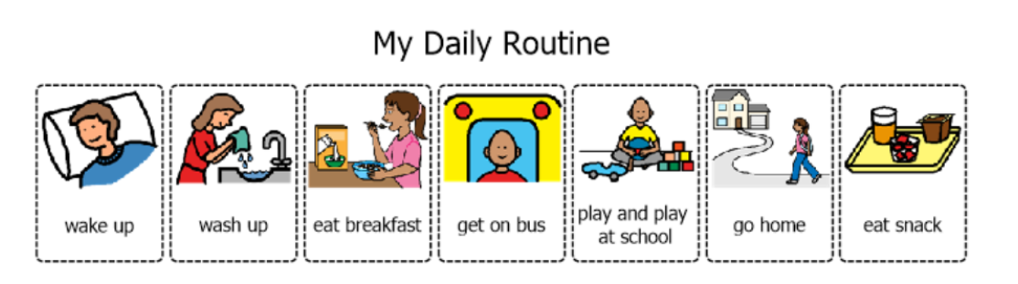
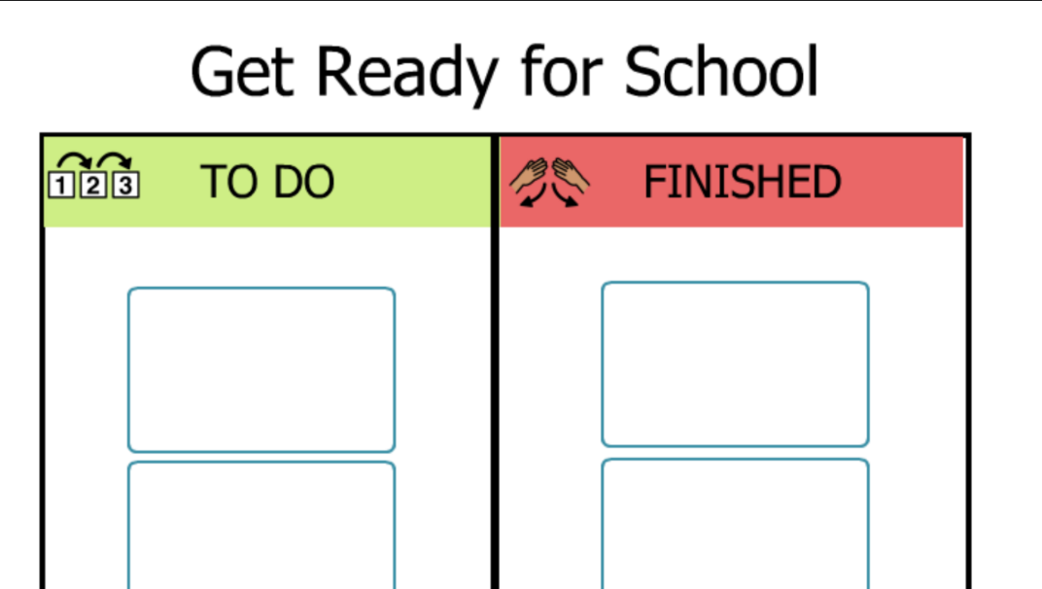
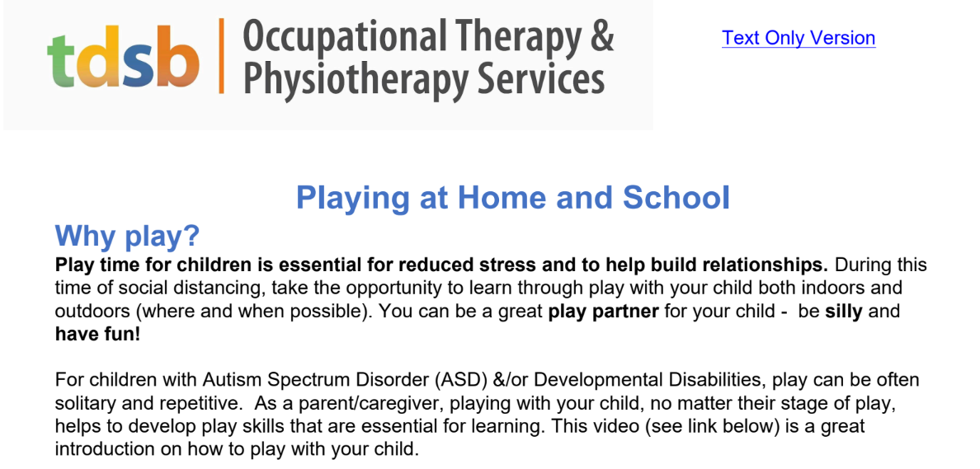
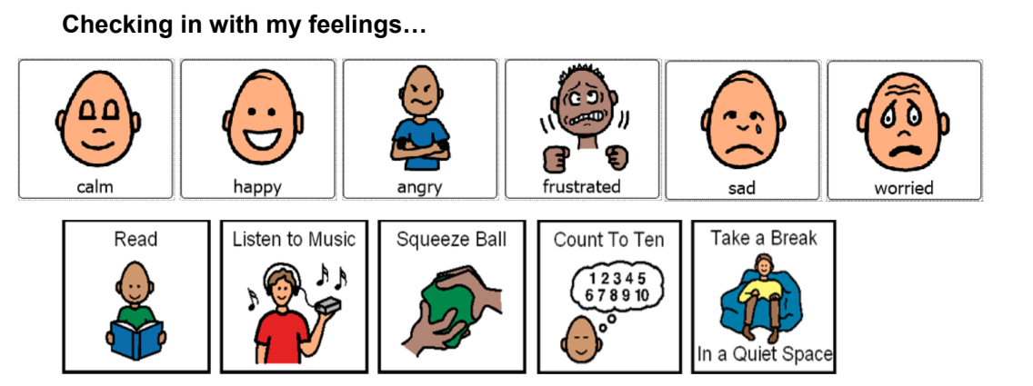
Occupational and Physiotherapy Services
Text-only version
Welcome back to school!
As we all prepare for the start of classes, help build your child’s routines by using visuals such as daily home schedules.
Visuals make routines clear and easy to understand. That way, your child will know what is expected of them.
Why visuals?
Visual aids support children who are still developing reading skills, English language learners, and neurodivergent children. Click on the image below for a sample visual.
Click on this link to access our Daily Routines handout.
Here are more visuals that you can use at home.
Regulation
Routines also play an important role in regulation as it provides children with predictable schedules increasing their sense of safety and security.
Further support your child's regulation at home by engaging in play. Click on the image below for more information.
Visuals and Regulation
Consider the use of visuals at home by completing daily feeling check-ins to help build your child’s emotional regulation skills. These check-ins help promote self-awareness, emotional literacy and coping strategies. Click on the image below for a sample “I feel” visual.
September 2026 | VOL 3 | ISSUE 1

Slide 4

Speech Language Pathology (SLP) Services
Language Spotlight: Building Oral Language Foundations
September Focus: Talking Before Reading
This year, our monthly focus will centre on developing oral language through one book: Fly in the Chai by Zenia Wadhwani. We have selected this book because it is written by a Toronto-based author and can be borrowed through the Toronto Public Library. Stay tuned each month to learn simple ways you can support your child’s language development using just one book.
This month, we are focusing on one simple but powerful strategy: talking about the book before reading it. This is called activating background knowledge. When children connect a story to what they already know, they are more likely to feel confident, share ideas, and engage in meaningful conversation. The goal is simple: use the book as a conversation starter—without reading it yet!
One Strategy for Home: Notice, Think, Connect
Before reading the story, take a few minutes to look at the cover together.
Notice: “What do you notice?”
Think: “What do you think this story might be about?”
Connect: “Does this remind you of anything we may have seen?”
There are no right or wrong answers—this is about encouraging your child to talk and share ideas.
If Your Child Needs Extra Support
Some children may need a little more structure to help them get started. You can support them by:
Using simple sentence starters: “I notice…” “I think…” “It reminds me of…”
Giving choices to help them respond (e.g., “Do you think it’s about a fly or a cat?”)
Allowing pointing, gestures, or one-word answers before building sentences together
Taking your time—thinking before speaking is part of the learning process
Why This Matters
These conversations help children:
build confidence in speaking
connect new ideas to their own experiences
develop early language and thinking skills
feel prepared and excited before reading
A Small Shift That Makes a Big Difference
You don’t need to read the whole book right away. Just talking about it first helps!
Looking Ahead
Next month, we’ll explore a new way to use the same story to build your child’s language skills in a different way.
September 2026 | VOL 3 | ISSUE 1

Slide 5
Blind and Low Vision Services
Getting the School Year Started Right:
Supporting Students with a Visual Impairment (BLV)
As we begin a new school year, there are many simple strategies that can make a significant difference for students who are blind or have low vision. Early accommodations help ensure students can access their learning environment, participate alongside their peers, and develop independence from the first day of school.
Students who have a diagnosed visual impairment, or who are experiencing difficulty visually accessing the curriculum, should be referred to the TDSB Blind/Low Vision Regional Services Team for consultation and support. An IST/SST is not required to discuss or initiate a referral.
Environmental Accommodations
Small changes to the classroom environment can improve accessibility and independence. Consider:
Placing lockers, cubbies, or hooks at the end of a row to make them easier to locate.
Seating students where they can best access instruction and classroom materials.
Designating a consistent location for assistive technology and specialized equipment.
Removing tripping hazards such as loose wires or curled rugs.
Encouraging students to push in chairs when leaving their workspaces.
Being mindful of lighting conditions and reducing glare where possible.
Instructional Accommodations
Accessible instruction benefits all learners. Helpful strategies include:
Using descriptive language when giving directions rather than relying on pointing or gestures alone.
Pairing visual demonstrations with verbal explanations.
Describing important facial expressions, diagrams, and visual information.
Providing copies of information presented on the board, interactive whiteboard, or anchor charts.
Using high-contrast colours and large, clear print when writing at a distance.
Curriculum Accommodations
Many students with visual impairments require adjustments to how information is presented. Consider:
Enlarging handouts and reducing visual clutter.
Using accessible fonts such as Arial, Century Gothic, or Atkinson Hyperlegible.
Selecting high-contrast materials whenever possible.
Providing audiobooks, digital texts, or alternate formats when appropriate.
Avoiding activities that rely heavily on colour recognition when colour vision is a concern.
The TDSB Blind/Low Vision Team is available to support school staff, students, and families in creating accessible learning environments and ensuring students have the tools they need to succeed.
September 2026 | VOL 3 | ISSUE 1

Slide 6
Deaf and Hard of Hearing Services
As we begin a new school year, simple strategies can make a meaningful difference for students who are Deaf or Hard of Hearing. Early accommodations help students access classroom communication, participate with peers, and build independence from the first day of school. Students with a known or newly identified hearing difference may require accommodations to support classroom learning. Newly identified students should be referred to the TDSB Deaf and Hard of Hearing Regional Services Team for support.
Visual supports, captioned media, clear routines, and reduced background noise improve access for D/HH students while benefiting many learners.
Environmental Accommodations
Small changes can improve listening and visual access. Consider:
Providing strategic seating with clear access to the teacher, peers, and interpreter when applicable.
Reducing background noise and supporting one person speaking at a time.
Using visual alerts and supports, such as written instructions, timers, or gesture signals.
Instructional Accommodations
Accessible instruction supports participation and understanding. Consider:
Facing the class when speaking and avoiding talking while writing on the board.
Repeating or rephrasing key information and peer contributions.
Providing captioned media and checking for understanding regularly.
Curriculum Accommodations
Students may require adjustments to how information is presented. Consider:
Providing written or visual instructions alongside spoken or signed directions.
Using visual supports such as diagrams, charts, and written steps.
Allowing extra time for processing auditory information and responding.
Check out the most recent edition of Sounding Board, the D/HH Student’s Newsletter.
International Day of Sign Languages: September 23, 2026
International Week of Deaf People 2026: September 21–27, 2026
Join students and staff across TDSB in celebrating our Deaf and Hard of Hearing community during International Week of Deaf People, recognized worldwide from September 21–27, 2026.
This year’s theme, Declaring Deaf People’s Human Rights, highlights the importance of access to language, communication, and community. September 23 is also the International Day of Sign Languages, and communities are encouraged to participate in “Shine a Blue Light on Sign Languages” to show support for sign languages and solidarity with Deaf communities around the world.
For more information, please visit the International Week of Deaf People 2026 website: The International Week of Deaf People 2026 website
September 2026 | VOL 3| ISSUE 1

Slide 7

Autism Regional Services
The beginning of the school year is the time when your child’s teachers will get to know them. Parents/ guardians and caregivers are an integral part of supporting those meaningful relationships. Whether your child is starting school for the first time, changing grades, programs or schools, sharing information early will help their teachers learn about them, As the school year begins, consider these ways to foster the connection between your child and their teachers..
Create a One-Page Profile: Include your child’s interests, sensory preferences, communication tips, and calming strategies
Schedule a Brief Meeting: A short conversation with the teacher can go a long way in building mutual understanding
Share What Works: Let the teacher know about successful strategies used at home or in previous classrooms
Provide Reports: Share any new or updated reports you have received from professionals or programs your child has attended
Stay Connected: Keep communication open throughout the year to celebrate progress and address needs together
Together, you and your child’s teachers can help create an environment where your
child feels seen, supported, and empowered to grow.
Supporting the Back-to-School Transition
Transitioning back to school is exciting and can be overwhelming for students with autism. Consider these strategies as your child settles into the new school year.
Create a Visual Schedule of the day
Use images or symbols to outline the daily school routine. This helps reduce anxiety and increase predictability.
Morning routine at home (wake up, brush teeth, backpack, bus)
School activities (class time, lunch, recess, etc.)
After school (snack, relax, homework)
Talk About Changes that have occurred
Discuss what is the same and what is different this year (e.g., new teacher, locker, subjects).
Review social stories on a regular basis addressing new experiences or transitions.
Support Emotional Readiness
Talk about feelings and role-play different scenarios happening at school
Use visual emotion charts or calming tools.
Prepare Comfort Tools
Adapt comfort item (if allowed) like a small fidget or photo.
Create a “calm-down kit” for the backpack (noise-canceling headphones, chewable necklace, sensory toy)
September 2026 | VOL 3 | ISSUE 1

Slide 8
Tip Sheet: Supporting Students with ADHD
🧠 What Is ADHD? Attention-Deficit/Hyperactivity Disorder (ADHD) is a neurodevelopmental condition that can affect attention, activity level, impulse control and skills such as getting started, staying organized and managing time. ADHD is not caused by poor parenting, lack of discipline, laziness, or too much screen time. It is related to how the brain develops and works. ADHD looks different for every child and teen. With support that builds on their strengths and responds to their needs, your child or teen can learn, grow and thrive.
❤️ How Families Can Help ✅ Start with strengths and listen: Notice your child’s interests, abilities and successful strategies. Ask what helps and what support they would find useful. ✅ Create routines and reminders together: Set up simple routines for mornings, schoolwork, activities and bedtime. Use checklists, calendars, timers or phone alerts based on their age and preferences. ✅ Make tasks manageable: Identify the first step and break larger tasks into smaller parts. Try completing two questions or working in timed blocks (e.g., 10 minutes) before taking a break. ✅ Make room for movement: Walking, stretching, getting a drink or changing workspaces may help with focus and regulation. ✅ Plan for strong emotions: Notice early signs of frustration or overwhelm and agree on what may help, such as taking space, moving or talking with someone they trust. ✅ Encourage self-advocacy and independence: Practise phrases such as, “I learn best when…” or “I need help with….”. Offer more choice and responsibility as confidence grows. ✅ Work with the school: Share strengths and strategies that work at home. Ask which supports can also be used at school and include your child or teen in the conversation.
💙 ADHD Can Look Like... A child or teen with ADHD may: Find it hard to focus, especially when a task is not interesting Focus deeply on favourite activities and find it hard to switch tasks Need reminders to get started, follow steps or finish Forget instructions, lose things or lose track of time Need to move, fidget or take breaks Speak or act quickly, or find waiting difficult Have strong feelings and need support to feel settled again They may also show strengths such as creativity, curiosity, energy, humour, persistence or strong knowledge in areas that interest them. Every child and teen is different, and their needs may change depending on the activity or environment.
📲 Resources and Support
TDSB Mental Health and Well-Being Resources – School-based mental health services and supports for students and families.
CADDAC: Centre for ADHD Awareness, Canada – Trusted Canadian ADHD information, practical strategies and family resources.
CADDRA: Canadian ADHD Resource Alliance – Evidence-informed Canadian guidance on ADHD assessment and treatment.
CAMH: Attention-Deficit/Hyperactivity Disorder – Ontario-based information on ADHD signs, diagnosis, treatment and support.
SNAP: Stop Now And Plan – Programs that build problem-solving, self-control and emotion regulation skills.
School Mental Health Ontario – Practical Ontario resources for child and youth mental health and well-being.
This resource is being shared for general informational and educational purposes only and does not constitute an endorsement by TDSB. This material does not constitute medical advice, diagnosis, or a professional assessment of any kind. You should always consult with a qualified professional for assessment, diagnosis, and treatment of any health concern. The external website links provided are operated by organizations outside of the TDSB. TDSB assumes no responsibility for the accuracy of the content of these materials. TDSB did not co-author any of these resources, nor is the Board affiliated with any of the listed organizations. These organizations are solely responsible for the preparation of the referenced materials, and other information found on their sites. Any comments or inquiries should be directed to the specific organization listed on the materials.
September 2026 | VOL 5 | ISSUE 1

Slide 9
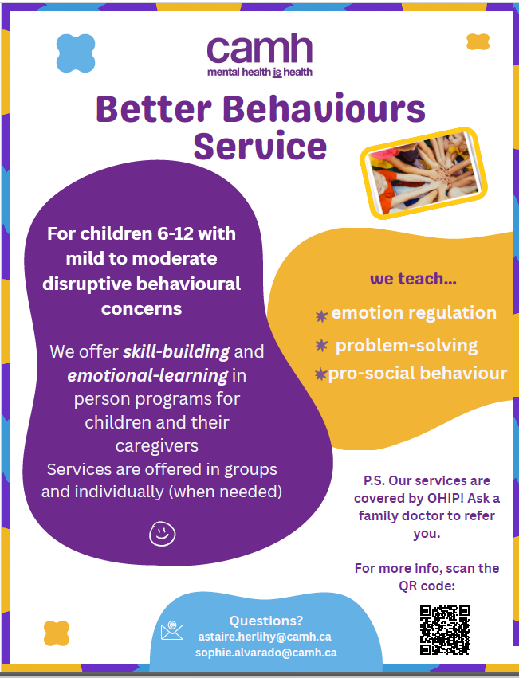
PResources
September 2026 | VOL 3 | ISSUE 1

