Slide 1
École virtuelle TDSB
Grade 4 Core French
vendredi le 25 septembre 2020

Slide 2
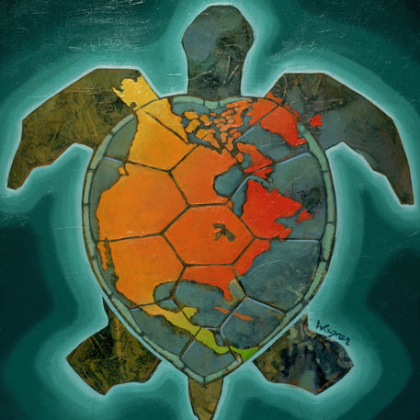
Texte reconnaissant de traités
Nous reconnaissons que nous sommes accueillis sur les terres des Mississaugas des Anichinabés, de la Confédération Haudenosaunee et du Wendat. Nous voulons également reconnaître la pérennité de la présence des Premières Nations, du Métis et du Inuit.
‹#›

Slide 3
Offers free French-language educational videos, digital books, apps and games to engage K-12 children in their second language learning
Subtitles available (use of French subtitles is suggested)
How to create an Idello account (parents and students)
IDÉLLO : Video Tutorial for Parents & Students on how to create an account
In order to access some resources that you will be using in class, it will be useful to have an account with Idéllo. If you don’t already have one, please take some time to set one up with the help of an adult.
Regarde la prochaine page.

Slide 4
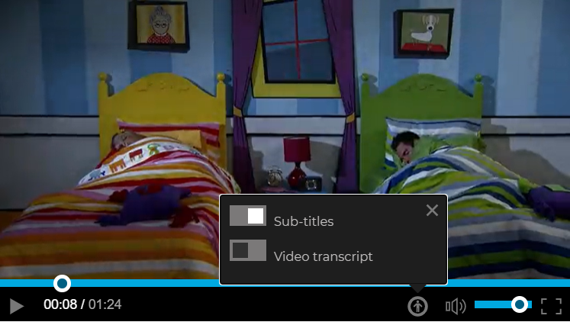
French subtitles
It’s a good idea to play the French subtitles while you watch a video. You might recognize some words and you can make a connection between the sounds and the words.
To turn on the subtitles, start a video. Then, click on the button and then click on “Sub-titles” like you see in this screenshot.

Slide 5
Please note...
For all documents, students can make their own copy so they may type and edit directly in their copy. Students may also choose to use a piece of paper and record their work if they prefer.
Merci!
Regarde la prochaine page.

Slide 6
Bonjour!
Bonjour! Bienvenue à la classe de français cadre!
Today is the vendredi and it is the 4th day of Core French (“le français cadre”) in the TDSB Virtual School.
Do you remember what you learned yesterday? Take a moment to reflect.
Regarde la prochaine page.

Slide 7
Review and practice
Can you complete the sentences and practice saying them aloud? If you need help, refer back to the documents from previous days.
Aujourd’hui, c’est ________ le ____ ____________ 2020.
jour # mois
Je m’appelle _______________.
J’ai ___ ans.
#
Mon anniversaire, c’est le ____ ______________.
# mois
Aujourd’hui, ça va _________ parce que ________________________.

Slide 8
Les célébrations
Every family and culture has special celebrations. Most
celebrations have a special meaning and unique traditions.
Quelles célébrations sont importantes pour toi et ta famille?
Regarde les exemples des célébrations dans le dictionnaire de vocabulaire de base.
Do you recognize any of them? What do you know about each celebration?
Do you celebrate any of these?
What are your traditions?

Slide 9
Quelle est ta célébration préférée?
Think about your “célébration préférée” (favourite celebration) or a special
event in your life.
Fais un dessin. Show how you feel about it and how you like to celebrate. For
a special event, describe the event and why you like it.
Write a short description to go with your drawing. You might include;
Details to say what the celebration or event is about (the purpose)
How you like to celebrate it and with whom
Special traditions that go along with the celebration/event
?
Essaye en français! (mais...You can write your description using French, English or another language if needed.)

Slide 10
Les célébrations et les événements spéciaux
Choose and watch one or more videos from the series “On fête ensemble”.
While you are listening, focus on the images you are seeing and understanding the main idea.You won’t understand all the words and that’s ok!
After listening, complete a Venn diagram to note the main ideas and any similarities between the celebration from the video and a celebration/event of your choice.

Slide 11
Bravo! À bientôt!

