Slide 1




February 2026 | VOL 2 | ISSUE 6
FEBRUARY HIGHLIGHTS
PAGE 1
What’s New
Important Dates
Parent/Legal Guardian Guides
Motor Skills
PAGE 2
Blind/Low Vision Newsletter
February’s Story Spotlight from Speech Language Pathology Services
PAGE 3
Student Spotlight: Nicholas from Don Mills Collegiate Institute
PAGE 4
TDSB Psychological Services: Supporting Anxiety
PAGE 5
From Occupational Therapy/Physiotherapy Services
PAGE 6
Understanding Auditory Processing Disorder
PAGES 7
Inclusive Education Month
White Cane Week
PAGE 8
Upcoming Transition Webinars
PAGE 9
TDSB Virtual Fair
Important Dates
Elementary PA Days:
February 13, 2026
June 5, 2026
June 26, 2026
Secondary PA Days:
February 13, 2026
June 25, 2026
June 26, 2026
School Year Holidays (as per Ministry):
Family Day: February 16, 2026
Mid-Winter Break: March 16-20, 2026
Good Friday: April 3, 2026
Easter Monday: April 6, 2026
Victoria Day: May 18, 2026
Motor Skills
Fine motor and gross motor skill development is crucial to promote independence and success with accessing school and community. These skills may be best developed by challenging bilateral integration - the use and coordination of both sides of the body. This also promotes communication between brain hemispheres strengthening neural pathways. For ideas on how to promote motor skills, coordination, and cognitive processing, this quick video from Occupational Therapy and Physiotherapy (OT/PT) Services shares bilateral integration strategies in day-to-day tasks.
Special Education and Inclusion Parent Guides
The Toronto District School Board (TDSB) provides many Special Education Guides for Parents which contain information about the supports, programs and services available for students with disabilities and special education needs in the TDSB.
If, after reading a guide, you require additional information, please reach out to the principal of your child’s school/your neighbourhood school. Videos and translated versions are also included within some of the guides.
Page 1

Slide 2




February 2026 | VOL 2 | ISSUE 6
Parent Resources
Blind/Low Vision Student Newsletter: Toward Independence
Toward Independence, the TDSB Blind/Low Vision Services Student Newsletter, is a long-standing tradition that highlights student voices and shares their lived experiences. The newsletter primarily features contributions from TDSB and TCDSB students with a visual impairment and is shared with peers who also receive Blind/Low Vision Services across the board.
The goal of Toward Independence is to build connection, foster self-advocacy, and provide students with the opportunity to see their experiences reflected in others. To ensure full accessibility, the newsletter is produced in multiple formats, including braille, large print, audio recordings, and AODA-compliant digital versions compatible with screen readers.
The Fall 2025 edition focuses on setting goals and looking ahead. We hope you enjoy reading these stories, reflections, and insights through a blind/low vision lens, and that they inspire you to think about your own goals.
Speech Language Pathology (SLP) Services
❤️ Big Voices, Big Hearts: February’s Story Spotlight
This month’s featured story is Eddie the Elephant Has Something to Say by Alison Johns - a heartwarming tale about finding your voice and sharing it with confidence! As Eddie learns to speak up using a communication device, your child will explore ideas of self-expression, confidence, and kindness.
In our lesson, your child will explore themes of belonging, identifying another’s perspective and practicing communicating in different ways.
At home, you can keep the conversation going by asking:
🐘 “When is it hard for you to speak up?”
🐘 “How would you help Eddie?”
💬 We hope this story encourages your child to use their voice
proudly and reminds them that every voice matters!
Please view the lesson here.
Page 2

Slide 3
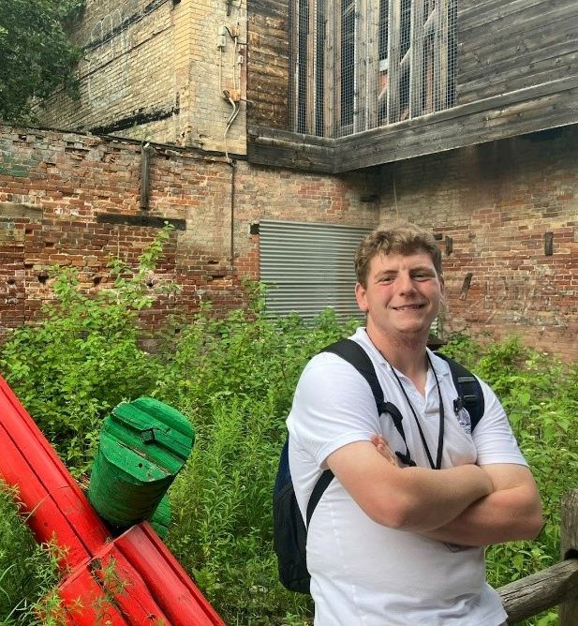

February 2026 | VOL 2 | ISSUE 6
Parent Resources
From Classroom to Creekside: Don Mills CI student embraces the outdoors at Evergreen Brickworks | Toronto District School Board Friday, December 5, 2025 Categories: News
Known by his nature name, Red Oak, Nicholas – a student at Don Mills Collegiate Institute – is a true lover of nature, so naturally he felt right at home during his placement at the Evergreen Brickworks Summer Adventure Camp.
He led free-play, arts and crafts activities, participated in nature walks where campers searched for turtles and explored the trails. He also built forts and sang camp songs with groups of 7-10 children ranging from 6 to 11 years old.
Nicolas shared he’s especially proud to take part in la fête. “It's a fun camp celebration where we sing songs and I get to play guitar in front of the group…it's so fun” he stated. A standout moment that brought smiles to everyone, including him. “I love it here.”
His placement was part of the Focus on Youth Toronto (FOYT) summer program, which is supported by Occupational Therapy and Physiotherapy Services within the Special Education and Inclusion Department.
“Nicholas is a joy to work with,” said his supervisor.
“He’s attentive, kind, and always brings a positive attitude. He often helps children feel included and is always willing to lend a hand.”
Nicholas’s love for nature, ability to connect with children, and dedication to his goals made him a positive force at camp this summer. and will surely serve him well for any of his future placements and potential employers. Nicholas has continued his learning with TDSB’s Project SEARCH, a transition-to-work program for youth with intellectual and developmental disabilities, to continue building his skills. His future goal - shared with a big smile is to “one day work in a hospital setting,” and he’s already on the path toward making that dream a reality.
Project Search: For Students | Project Search Toronto
CLICK HERE TO WATCH VIDEO
Page 3

Slide 4

February 2026 | VOL 2 | ISSUE 6
Parent/Legal Guardian Resources
Anxiety
In moments of stress - whether it’s a pop quiz, social tension, or a misunderstood instruction, a child’s brain may activate its survival mode: fight, flight, or freeze. This response, governed by the amygdala, is meant to protect us from danger. This might show up as defiance, avoidance, or zoning out. This is the nervous system doing its job. When parents or teachers recognize these cues with curiosity, they create space for regulation and connection. Adults can use the following strategies to support children with anxiety:
Normalize Anxiety: Talk openly about anxiety as a common human experience. This helps reduce stigma and encourages children to seek help when needed.
Validate Emotions: Acknowledge feelings without judgment. Saying things like, “It makes sense you’d feel nervous before…,” builds trust and emotional safety.
Create Predictability: Use consistent routines and clear expectations. This reduces uncertainty, which is a trigger for anxious children.
Offer Calm Spaces: If possible, designate a quiet corner/area/room with some sensory tools or familiar items, breathing prompts, or calming visuals where children can self-regulate.
Teach Coping Skills: Integrate mindfulness, breathing exercises, and emotional regulation techniques into daily routines.
Build Relationships: Check in regularly with children. A strong adult-child bond can buffer anxiety and foster resilience.
Model Calm Behaviour: Your tone, body language, and reactions set the emotional climate. Staying calm helps children feel safe.
Utilize Support: Families can consult with their school team, including administrator, or School Support Team members for ideas that may be beneficial.
Page 4

Slide 5

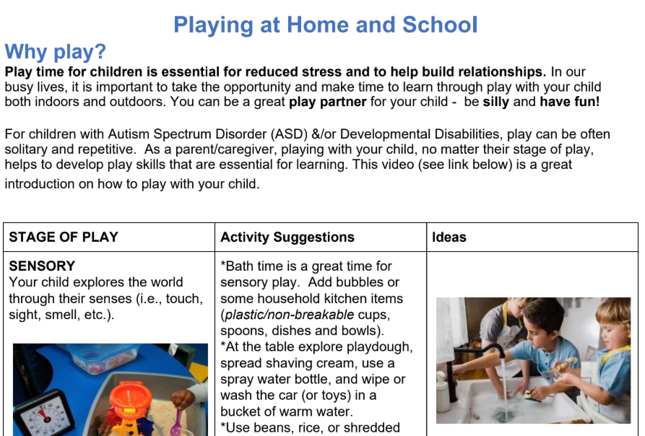
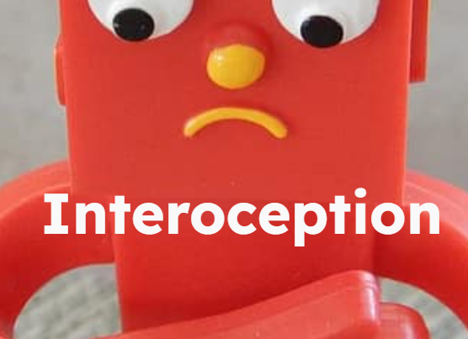
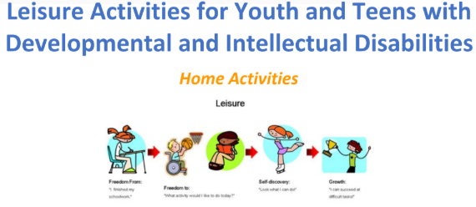

From Occupational Therapy/Physiotherapy Services
Text-only version
“Play is the work of a child”
- Maria Montessori.
Play is essential for children to reduce stress and build healthy relationships. As parents/ caregivers we can be great play partners!
There are many stages to play- what stage is your child in? Check out this handout on play to discover the stages of play and fun activities to try in the different stages!
It’s Health Awareness Month
In recognition of Health Awareness Month, we’re sharing insights on interoception - your body’s internal messaging system that helps you recognize how you’re feeling from the inside out.
The Eighth Sensory System - Interoception
This Eighth Sensory System helps us notice what’s going on inside our bodies so we can better care for ourselves. It helps us:
🍽️ Know when we’re hungry or full
🥤 Feel when we’re thirsty
😣 Notice pain in our body
🌡️ Sense if we’re too hot or too cold
❤️ Understand heartbeat and heart rate
🤢 Notice when we feel nauseous or sick
😴 Tell when we’re sleepy or tired
🚽 Feel when we need to use the washroom
😮‍💨 Understand when we’re out of breath
Leisure for Youth and Teens
Looking for some ideas for your older child at home? Make a weekly or monthly games night with your teen and pull out the board games. Click below for more ideas. Don’t forget to hook them in with their favourite snacks!
m
Click here or on the image to find out more about Interoception.
Page 5

Slide 6
February 2026 | VOL 4 | ISSUE 6
Parent/Legal Guardian Resources
Deaf and Hard of Hearing Services
Understanding Auditory Processing Disorder
Auditory Processing Disorder (APD) is a condition in which a child has typical hearing, but the brain has difficulty processing and making sense of sound, particularly spoken language. Children with APD often describe the experience as hearing, but not understanding. APD does not involve damage to the ears. Instead, it affects how the brain interprets sound, especially in environments with background noise, fast-paced instruction, or complex verbal information, such as classrooms.
How APD May Affect Students at School
Children with APD may:
Have difficulty understanding speech in noisy or large group settings
Find it challenging to follow verbal or multi-step instructions
Experience increased listening fatigue throughout the school day
Need information repeated or presented in different ways
As these challenges can look similar to attention or learning difficulties, APD is sometimes misunderstood. A formal assessment by a clinical audiologist is required to diagnose APD.
How Schools Support Students with APD
Most students with APD are well supported through classroom-based strategies, such as:
Preferential seating
Reducing background noise where possible
Visual supports and written instructions
Repetition or re-phrasing of key information
These strategies are planned and monitored by the school team and may be documented in an Individual Learning Plan (ILP) or Individual Education Plan (IEP), depending on the student’s needs.
When Additional Support May Be Considered
In some cases, a clinical audiologist may recommend trying a Remote Microphone (RM) system to support listening in the classroom. RM systems are not required for all students with APD and are considered only when recommended through assessment and when school-based strategies alone are not sufficient.
When an RM trial is recommended:
The school works with central support staff to determine next steps
The trial is time-limited and closely monitored
Decisions are based on whether the technology meaningfully improves access to instruction
Families with questions about APD supports are encouraged to speak with their school team, who can help determine appropriate next steps. When recommended by a clinical audiologist, the school team may refer to Deaf and Hard of Hearing Regional Services to explore an RM system trial as part of a broader support plan.
Page 6

Slide 7

February 2026 | VOL 2 | ISSUE 6
Parent/Legal Guardian Resources
Inclusive Education Month
February is National Inclusive Education Month, a time to recognize and celebrate inclusive education across Canada. This month highlights what inclusive education means and how inclusive schools and practices support high-quality learning for an increasingly diverse student population, including students with intellectual disabilities.
Inclusive Education Month also provides an opportunity for educators, students, and families to share ideas and strategies that strengthen inclusion and promote positive, successful school experiences for every learner. We take this time to acknowledge and celebrate the commitment and efforts of teachers, administrators, students, and families/guardians who contribute to meaningful inclusion in schools and classrooms across the TDSB.
National Inclusive Education Month raises awareness and deepens
Understanding of inclusive education. Please explore the links below
for additional information, learning opportunities, and resources
Community Living Ontario Resources
A Parent’s Handbook on Inclusive Education
White Cane Week: February 1, 2026
White Cane Week is celebrated in Canada during the first full week of February each year. This year, it will begin on February 1, 2026. White Cane Week is an opportunity to raise awareness and deepen understanding of the lived experiences of individuals with a visual impairment. It raises awareness to the unique challenges that impact Canadians who are blind, Deafblind, or who have a visual impairment. The white cane is a powerful symbol, signalling to others that the user has a visual impairment, while also representing independence. The white cane enables individuals who are blind, Deafblind, or who have a visual impairment to navigate their environments safely and confidently.
The TDSB supports students who use white canes for safe travel with specialized instruction from Orientation & Mobility Specialists. Through direct instruction, students develop the skills needed to move safely through their school and community environments with increasing confidence and autonomy.
To celebrate White Cane Week, check out this reading list developed by the Toronto Public Library in collaboration with CELA titled: Reading Beyond Vision.
Page 7

Slide 8
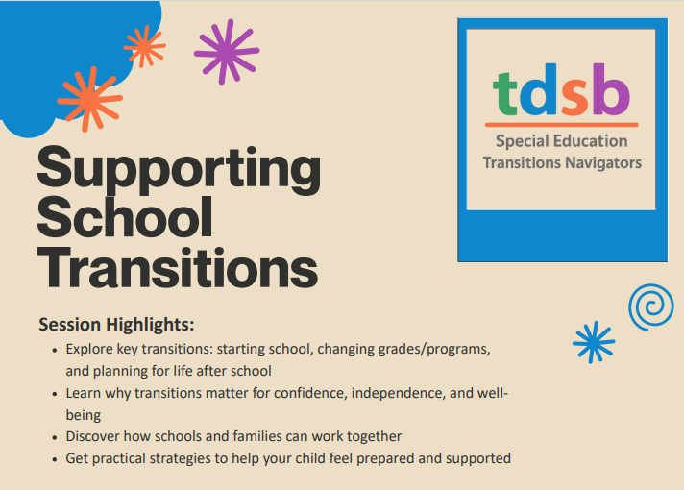
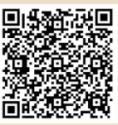

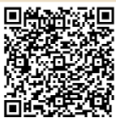
February 2026 | VOL 2 | ISSUE 6
Parent/Legal Guardian Resources
PLEASE CHOOSE ONE SESSION
Session 1:
Feb 24,2025 at 10:00AM -11:30AM
Click HERE or scan QR code to register:
__________________________________________________________________________
Session 2:
Feb 25, 2026 at 6:30PM -8:00PM
Click HERE or scan QR code to register:
Page 8

Slide 9
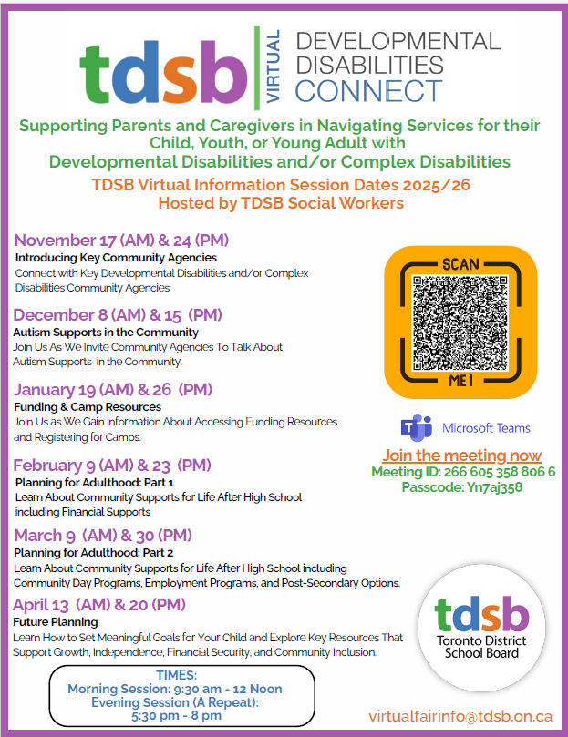
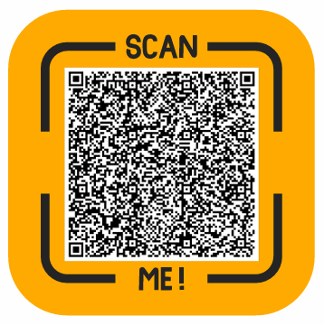
February 2026 | VOL 2 | ISSUE 6
Parent/Legal Guardian Resources
Page 9

