Slide 1
BLACK MENTAL HEALTH
2024
BLACK MENTAL HEALTH
2024
Created by TDSB Mental Health Leads . Any copying or adaptation requires acknowledgements.

Slide 2
In March 2020, the Provincial Government passed Bill 178, Black Mental Health Day Act. This day was initially recognized by the City of Toronto, Taibu Community Health Centre, CAFCAN and Strides Toronto. In 2021, Black Mental Health Day was expanded to Black Mental Health Week.
At TDSB we recognize the impact Anti-Black racism continues to have on the mental health and well- being of individuals, students and families.
A day or a week is not sufficient---supporting Black mental health and well-being must be every day. Anti-Black racism has deeply rooted impacts on the emotional well-being for Black communities and we recognize and understand this emotional impact is real, present and daily.
Positive Black mental health, wellness and well-being, are adversely impacted by Anti-Black racism, which is woven into the fabric of our institutions and systems. We remain committed to further developing our understanding that racial stress and trauma result in fatigue, exhaustion, distrust of mental health supports and the silencing of Black voices.

Slide 3
BLACK MENTAL HEALTH MATTERS
Members of the Mental Health and Well-being Committee at the TDSB, along with our Colleagues in Professional Support Services, wish to acknowledge the importance of Black Mental Health Week from March 4th to March 10th, 2024
We recognize the important role that schools play in acknowledging, understanding and having critical conversations on the impacts of racial stress and trauma on the mental health and well-being of Black students and families. Our collective work requires us to learn, unlearn and support the healing of racial trauma. We need to centre culturally responsive and restorative healing spaces for Black students and families, which will contribute to positive outcomes and overall mentally healthy schools.
It is through this that we can acknowledge and support meaningful and accessible connections to culturally responsive resources. In addition, seeking support from professionals that identify with the Black Diasporic communities is central in supporting Black mental health and well-being.
The next slides provide links to TDSB and community resources, activities and videos that can support positive Black mental health.

Slide 4
Critical Community & Agencies Conversations About
Anti-Black Racism & Importance of Black Mental Health (click on posters, cups, books)

Slide 5
(Click on Links)
Jason Best and Karlene Haughton
Youth Outreach workers
Chris Leonard
Grief and Loss Facilitator
Imani Hennie
TDSB Itinerant Mental Health Lead

Slide 6
Toronto Black Mental Health Week
2024 Events
(Click on poster)

Slide 7
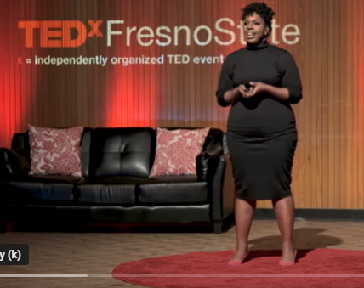
SELF-REFLECTION
TEDx & TALKS (click on posters)
“Black Voices & Spoken Words”
The Black Male Mental Health Struggle
Casper Jasper -TEDxGeorgia Tex Salon
Dear Black Women, Lets Talk About Healing
Angela Bowden-TEDxMSVUWomen
Disrupting the miseducation of African American Youth: Kwame Shaka Opare at TEDx ChesterRiver

Slide 8
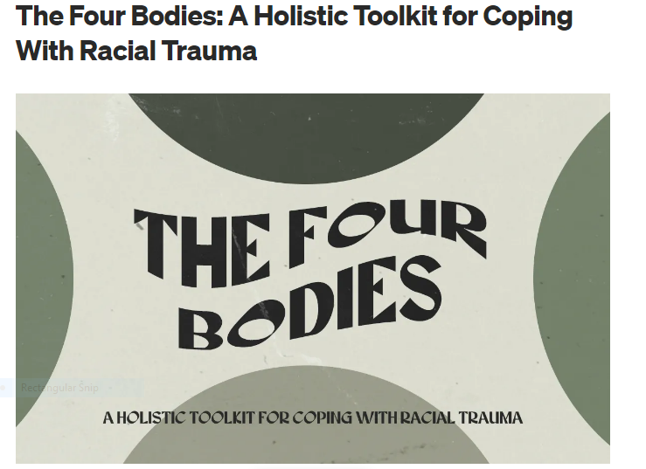
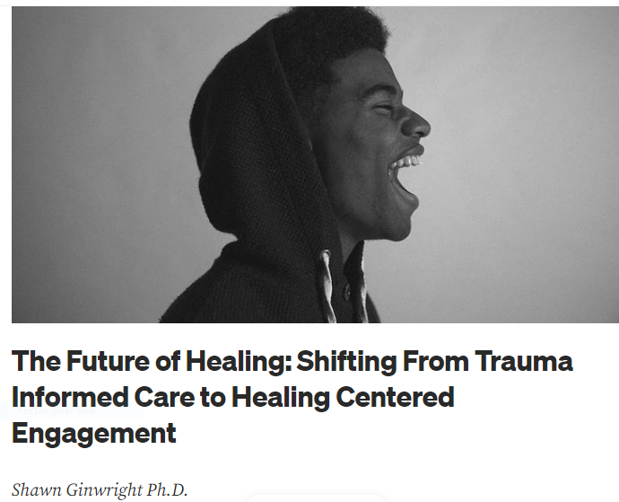
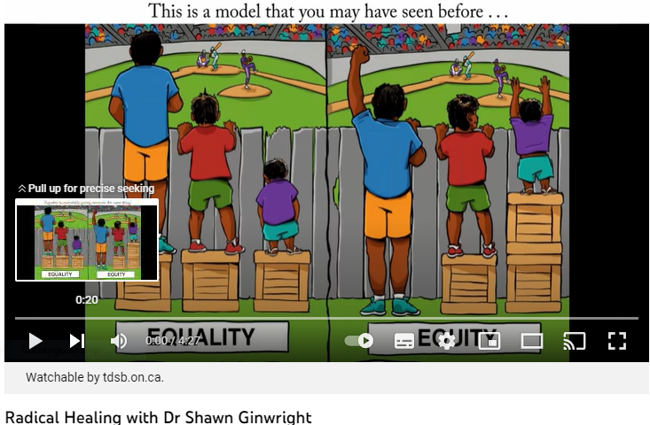
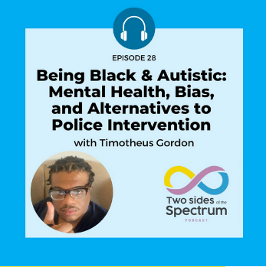
DISMANTLING ANTI-BLACK RACISM AND HEALING CENTERED ENGAGEMENT RESOURCES

Slide 9
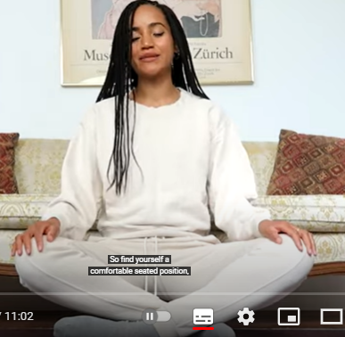
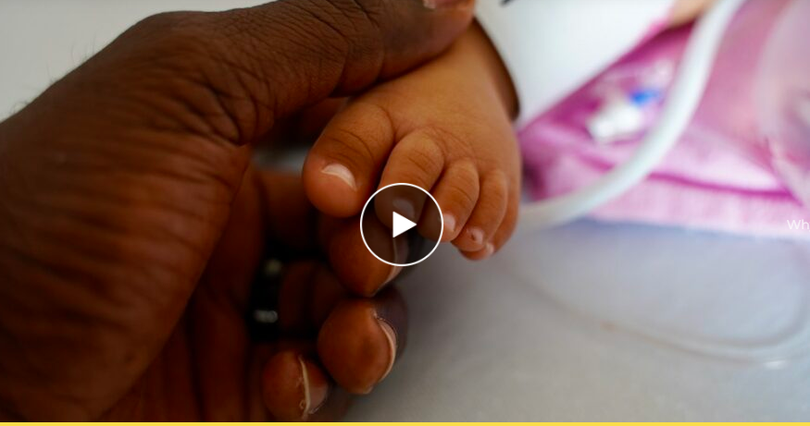
“Growth and Reflection”
(click on Posters)
Mindfulness & Affirmations
Black Joy is Eternal

Slide 10
Other Resources Thought Pieces
Racism, Health & What You Can Do About
Violence, Racism and Mental Health: Where do we go from here
It’s a traumatic moment’: How everyday racism can impact mental, physical health
White Anti-Racism: Living the Legacy
Anti Black Racism | BPAO
Workplace Resources
Workplace strategies for mental health: Inclusivity & Mental Health
Toolkit on Race and Mental Health at Work (Pan-European)
https://www.oise.utoronto.ca/ciars/UserFiles/File/ABR_Resource_Guide-FINAL.pdf
Resources to Strengthen Your Ability to Be a Strong Ally
Resources to Strengthen Your Ability to Be a Strong Ally
Article: Becoming Trustworthy White Allies
Article: Understanding and Dismantling Racism: A Booklist for White Readers
Centre for Social Intervention: How to Be an Ally: Anti-Blackness at the Intersections panel recap
10 Books about race to read instead of asking a Person of Color to explain things to you

Slide 11
Black Community Services & Resources
(Click on posters for information)

Slide 12
Imani Hennie-Hamadi, MSW/RSW
Itinerant Mental Health Lead
Annette Grossi, MSW/RSW
Itinerant Mental Health Lead
Roshni Malhotra,
Professional Support Services Administrative Assistant
Shameen Sandhu, MSW/RSW
System Leader Mental Health & Professional Support Services
CREATED BY:

