Slide 1
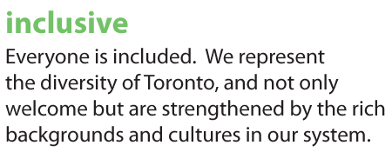
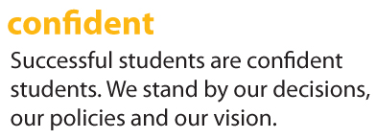
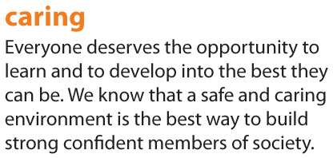
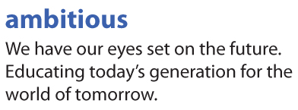
(UDL) Universal Design for Learning Universal Design is not just a technique for special education; rather it is a technique to enhance the learning of all students.
Notes:
Ensures all learners always have access to all aspects of learning: that is inclusive, ambitious, confident and caring
Its aim is to assist teachers in designing products and environments to make them accessible to everyone, regardless of age, skills, or situations.

Slide 2
The BIG Idea
UDL is
flexible, supportive, and adjustable, and increases full access to the curriculum for all students.
UDL sees
all learning as a continuum.
Every student is unique
and will therefore benefit from a flexible curriculum that provides him or her with the appropriate pathways for reaching learning goals, as well as fair and accurate assessment.

Slide 3
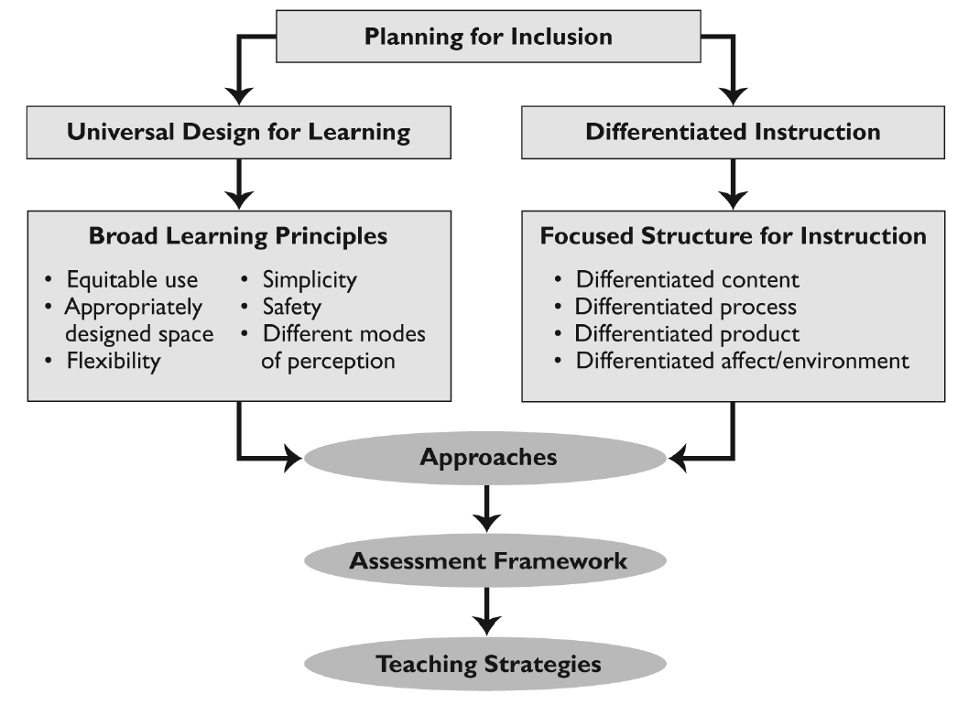
Responds to students strengths & needs.
UDL/DI Framework
“In a diverse classroom, no single method can reach all learners. Multiple pathways to achieving goals are needed.”
Notes:
Used in combination, UDL and DI enable educators to respond effectively to the strengths and needs of all students. UDL provide educators with broad principles for planning instruction for a diverse group of students, whereas DI allows them to address specific skills and difficulties.
The two approaches overlap, sharing certain goals and strategies, such as providing a range of instructional strategies, resources, activities and assessment tools in order to meet the different strengths, needs, readiness and learning styles or preferences of the students in a class.
“In a diverse classroom, no single method can reach all learners. Multiple pathways to
achieving goals are needed.” (Hitchcock et al., 2002, p. 18)

Slide 4
UDL Principles
Universality & Equity
Using 21st Century Technology in the classroom allows students to have equitable access to programming and resources to support their own learning - expression of learning.
Flexibility & Inclusion
Including student voice as a focal point in every classroom environment (incorporated in a purposeful way) will seek out the strengths and attributes of all students.
Appropriately Designed Space
Creating a safe, inclusive and accepting learning environment which promotes fairness, equity, and respect for all will create a sense of belonging and connectedness.
Safe Environment: “Belonging”
Developing (co-constructing), creating and implementing a student-driven learning profile allows for a greater sense of belonging in the classroom.
Simplicity: Learning Goals & Success Criteria
Engages students in their understanding of the “big idea” and subsequently their connection to their own learning profile and learning goals.

Slide 5
Why these principles are important…
Increases Student Engagement
Builds Community
Supports 21st Century Learning
Meets Diverse Learning Needs
Allows the student to demonstrate capabilities
Ensures Student Voice
Develops Self-Advocacy
Supports the achievement and well-being of all
Environment where students feel free to take risks
Promotes A Positive School Climate
Emphasizes ability
Improves Accessibility to Learning Opportunities
Connected to the students’ real world
Supports transitions into new learning environments

Slide 6
UDL: Belonging and Inclusion
The greatest stratification in students’ experiences of belonging and exclusion exists across learning environments.
Building a positive school climate means embedding the principles of equity and inclusive education in all aspects of the learning environment.
If the school environment, inside and outside the building, is welcoming and makes the school a safe, inclusive and accepting place …it will be conducive to learning for all.

Slide 7
Investment in Teaching Excellence Session A1

Slide 8
Notes:
End.

