Slide 1
Toronto District School Board
2022-23 Budget Presentation
Last revised: April 25, 2022
Notes:
Good afternoon and welcome to the 2022-23 TDSB Budget Information Session.

Slide 2
Acknowledgement of Traditional Lands
We acknowledge we are hosted on the lands of the Mississaugas of the Anishinaabe (A NISH NA BEE), the Haudenosaunee (HOE DENA SHOW NEE) Confederacy and the Wendat. We also recognize the enduring presence of all First Nations, Métis and Inuit people.
Reconnaissance des Terres Traditionnelles
Nous reconnaissons que nous sommes accueillis sur les terres des Mississaugas des Anichinabés (A NISH NA BEY), de la Confédération Haudenosaunee (HOE DENA SHOW NE) et du Wendat. Nous voulons également reconnaître la pérennité de la présence des Premières Nations, des Métis et des Inuit.
Notes:
We will start by reading the land acknowledgement. We acknowledge we are hosted on the lands of the Mississaugas of the Anishinaabe the Haudenosaunee Confederacy and the Wendat. We also recognize the enduring presence of all First Nations, Metis and Intuit People.

Slide 3
Budget Topics
Budget Development Overview, Timelines and Drivers
Funding Gaps and Impact of the Pandemic
2022-23 Ministry Funding Announcement
Enrolment Projections
Key Components of Education Funding
2021-22 Financial Projections and Reserves Balance
2022-23 Financial Projection
Budget Challenges and Risks
Notes:
The Ministry technical papers, Grants for Student Needs and Priorities and partnership funding announcements were released on February 18, 2022. They outline any policy or funding changes to the 2022-23 Education funding. Generally funding for school boards is calculated based on a set of provincial benchmark costs and are tied to student enrolment. Instruction costs make up over 76% of the TDSB expenditures, and school based staffing costs are calculated based on class sizes and staffing ratios. Some areas of funding may also be ‘enveloped’, which means they are restrictive in how they are used. By law, all school boards must balance their budgets by June 30th each year, and trustees and staff work together to approve and finalize the budget for Ministry submission.

Slide 4
TDSB Budget Development Overview
The TDSB is one of the largest and most culturally diverse school boards in Canada, serving approximately 230,000 students in 583 schools throughout Toronto, and has approximately 38,000 employees.
TDSB’s annual budget is approximately $3.4 billion, 76% of its budget is allocated to staffing costs, educational tools and classroom materials. Approximately 10% of the budget relates to school operations, such as caretaking, utilities and maintenance. 12% of the budget relates to transportation, renewal, amortization, fundraising and other fixed costs. Only 2% of the budget relates to administration.
Only a small percentage of the TDSB budget is considered flexible or discretionary.
Notes:
The Ministry technical papers, Grants for Student Needs and Priorities and partnership funding announcements were released on February 18, 2022. They outline any policy or funding changes to the 2022-23 Education funding. Generally funding for school boards is calculated based on a set of provincial benchmark costs and are tied to student enrolment. Instruction costs make up over 76% of the TDSB expenditures, and school based staffing costs are calculated based on class sizes and staffing ratios. Some areas of funding may also be ‘enveloped’, which means they are restrictive in how they are used. By law, all school boards must balance their budgets by June 30th each year, and trustees and staff work together to approve and finalize the budget for Ministry submission.

Slide 5
Budget Development Process
Provincial funding announced every spring
Funding determined by benchmarks, or the Ministry of Education’s funding formula, and student enrolment
Benchmarks do not reflect the realities of operating schools in Toronto
School boards required (by law) to pass a balanced budget by June 30
Trustees and staff work together to create a balanced budget that best supports the achievement and well-being of students within the funding provided
Notes:
The Ministry technical papers, Grants for Student Needs and Priorities and partnership funding announcements were released on February 18, 2022. They outline any policy or funding changes to the 2022-23 Education funding. Generally funding for school boards is calculated based on a set of provincial benchmark costs and are tied to student enrolment. Instruction costs make up over 76% of the TDSB expenditures, and school based staffing costs are calculated based on class sizes and staffing ratios. Some areas of funding may also be ‘enveloped’, which means they are restrictive in how they are used. By law, all school boards must balance their budgets by June 30th each year, and trustees and staff work together to approve and finalize the budget for Ministry submission.

Slide 6
2022-23 Budget Timelines
November 2021
December 2021
January 2022
February 2022
Preliminary budget discussions and communications support System enrolment projection for 2022-23 Release of Ministry Funding Guide & public consultation survey | Submit final response to Ministry of Education Budget Consultation Update on 2020-21 Financial position and reserves 2021-22 Revised Estimates submitted to the Ministry in mid-December | Fine tune School-based enrolment projections for 2022-23 Public consultation on proposed strategic budget drivers from Dec 8 to Jan 31 | Approval of strategic budget drivers 2022-23 enrolment projections & preliminary financial forecast Ministry GSN funding announcement 2021-22 First quarter report Financial facts report

Slide 7
2022-23 Budget Timelines (cont’d)
March 2022
School-based staffing allocation (Teachers and Support Staff) Release of 2022-23 GSN technical papers on Mar 25. | 2021-22 Second quarter report and revised financial projection and reserves status Preliminary 2022-23 financial projection | Internal discussions around options to balance the 2022-23 budget 3 year financial forecast and multi-year deficit recovery plan. Virtual town hall meetings and public budget information sessions | Board Approval of Operating and Capital Budget Submission of 2022-23 Budget to the Ministry by 30th of June
April 2022
May 2022
June 2022

Slide 8
2022-23 Budget Drivers
Help guide the budget development process.
Approved by Trustees on March 9
All are important but presented below based on the budget priority ranking gathered from public consultation:
- Mental health and well-being
- Staff allocation to support students
- Equitable access to learning opportunities, including Indigenous Education
- Student success
- Human rights
- Modernization and accessibility
- Pandemic recovery
- Parent engagement and student voice
- Professional development
- Early years

Slide 9
Funding Gaps
What happens when the funding provided by the provincial government does not fully meet the needs of students in Toronto?
TDSB provides additional financial support above what the Ministry funds to meet student needs through in-year savings, efficiencies, reserves, etc.
While savings, efficiencies and reserves help address these gaps, they are not enough to cover all recurring funding shortfalls
Resulted in the TDSB’s annual structural deficit

Slide 10
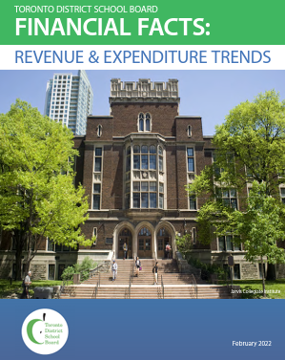
Funding Gaps (cont’d)
Significant funding gaps in areas such as Special Education and Information Technology
Following chart outlines the significant funding gaps faced by the TDSB (before they are offset)
See the Financial Facts on the TDSB’s Budget page for more information

Slide 11
Budget Challenges: Funding Gaps
Funding Gap School Based | 2021-22 Provincial Funding ($Mil) | TDSB 2021-22 Projected Actuals ($Mil) | Funding Gap ($Mil)
Elementary Teachers | 1,092.4 | 1,158.2 | 65.9
Secondary Teachers | 490.6 | 516.4 | 25.8
Supply Staff | 53.6 | 101.6 | 48.0
Early Childhood Educators | 67.1 | 71.6 | 4.5
Principals & Vice-Principals | 110.7 | 137.6 | 26.9
School Office Support | 60.2 | 73.4 | 13.1
School Budget Expenditures | 46.6 | 47.0 | 0.4
Total School Based Gap |  |  | 184.5
Notes:
The table below summarizes the projected 2021-22 significant provincial funding gaps between the TDSB costs and provincial fundings (excluding the time-limited COVID related funding in 21-22 school year).
*The school based funding gaps above include Special Education staffing

Slide 12
Budget Challenges: Funding Gaps (cont’d)
Funding Gap | 2021-22 Provincial Funding ($Mil) | TDSB 2021-22 Projected Actuals ($Mil) | Funding Gap ($Mil)
Transportation | 63.4 | 63.9 | 0.5
Information Technology | 14.7 | 68.6 | 53.9
Special Education | 353.2 | 428.8 | 75.6
Notes:
The table below summarizes the projected 2021-22 significant provincial funding gaps between the TDSB costs and provincial fundings (excluding the time-limited COVID related funding in 21-22 school year).

Slide 13
Impact of the Pandemic
COVID-19 has had a significant impact on the TDSB budget
All available resources used to keep students and staff safe
- e.g. additional staff & smaller class sizes to support physical distancing
TDSB reserves were used because Ministry funding was not enough to keep students and staff safe
Trustees and staff continue to advocate that the Ministry recognize the challenges that the TDSB faced during the course of the pandemic

Slide 14
Impact of the Pandemic (cont’d)1
Declining Enrolment
Enrolment has been declining since the start of the pandemic (2020)
- Families keeping four and five year old children at home
- Fewer families settling in Toronto
- With the ability to work from home, families relocated to other municipalities
Has resulted in a significant decrease in GSN revenues
Enrolment stabilization funding helped offset revenue impact in 2020-21 but this support is no longer available in 2021-22 and 2022-23

Slide 15
Impact of the Pandemic (cont’d)2
Students need stability and support
We do not want to make cuts and reductions at such a critical time
We need full financial support of the TDSB’s thorough and actionable Pandemic Recovery Plan to address the long-term impacts of the pandemic on student learning, mental health and well-being
We also ask for continuation of enrolment stabilisation funding
Reimbursement of all pandemic-related expenses incurred by school boards over the past two years

Slide 16
2022-23 Ministry Funding Announcement
On February 17, the Ministry of Education announced the 2022-23 Grants for Students Needs (GSN) funding, Capital Funding, and Priorities and Partnership Funding
The Supports for Student Fund that was used for additional staffing supports will continue
Additional staffing supports from the 2021-22 COVID-19 Learning Recovery funding will continue
Notes:
We will be receiving $3.95M for transportation Health & Safety PPF funding. $1.98M or half of this will be in the budget and will be used for additional bus routes, and enhanced cleaning on buses. We will have $0.55M in half year special education supports and $0.62M in mental health and well being supports. These funding will be used towards additional staffing, training and other resources. At this time, the plan for utilizing mental health funding is still underway and more information around use of this funding will be available over the coming weeks.

Slide 17
2022-23 Ministry Funding Announcement (cont’d)1
These additional school based staff positions were allocated from the 2022-23 Supports for Student Fund and COVID staffing support funding:
School-Based Staff | Additional positions from Supports for Student Fund (FTE) | Additional positions from COVID-19 Learning Recovery Fund (FTE)
Elementary Teachers | 34.5
Special Education Elementary Teachers | 43.5
Secondary Teachers | 36.0
Secondary Teachers - Guidance |  | 20.0
Vice Principals |  | 37.5
Special Education Support Staff | 66.0 | 35.0
School Office Clerical | 23.5 | 25.0
School Based Safety Monitors |  | 40.0
Lunchroom Supervisors (headcount) |  | 200.0
Caretaking | 30.0 | 78.5
Notes:
I will now provide a quick recap of the Ministry funding announcements in early May and the funding impact in each of the corresponding areas.

Slide 18
2022-23 Ministry Funding Announcement (cont’d)2
Recent Immigrant Supplement
Student mental health ($10M across the province)
Increase to the Special Education Equipment (SEA) per pupil amount ($7.4M across the province)
Increase of $39.9M (across the province) in Broadband Network Operations support
Increases in non-staff school operations allocation
2% cost increase to the Student Transportation grant
$7.9M (across the province) to support French as a Second Language initiatives

Slide 19
2022-23 Enrolment Projections
Pupils of the Board | Actual 2020-21 | Projected 2021-22 | Projected 2022-23 | 21-22 vs. 20-21 | 22-23 vs. 21-22
JK/SK | 31,557 | 30,566 | 30,135 | (991) | (431)
Grade 1-3 | 51,688 | 49,311 | 47,320 | (2,377) | (1,991)
Grade 4-8 | 84,381 | 81,889 | 80,312 | (2,492) | (1,577)
Total Elementary | 167,626 | 161,766 | 157,767 | (5,860) | (3,999)
Secondary | 68,179 | 69,087 | 68,857 | 907 | (230)
Total Day School | 235,805 | 230,853 | 226,624 | (4,953) | (4,229)
Notes:
As you can see in the previous slide, the reduction in enrolment is attributed to the drop in newcomers. We also saw a significant decrease in kindergarten student enrolment as well. For 2021-22 year, we are projecting that the Junior Kindergarten enrolment will bounce back and will improve from prior year’s revised estimates enrolment projections. However we continue to experience declines in overall enrolment in the elementary panel. For the Secondary panel, we are anticipating some enrolment growth compared to last year, as the vaccination rates of children 12 and over continue to increase and as government lifts their travel restrictions.

Slide 20
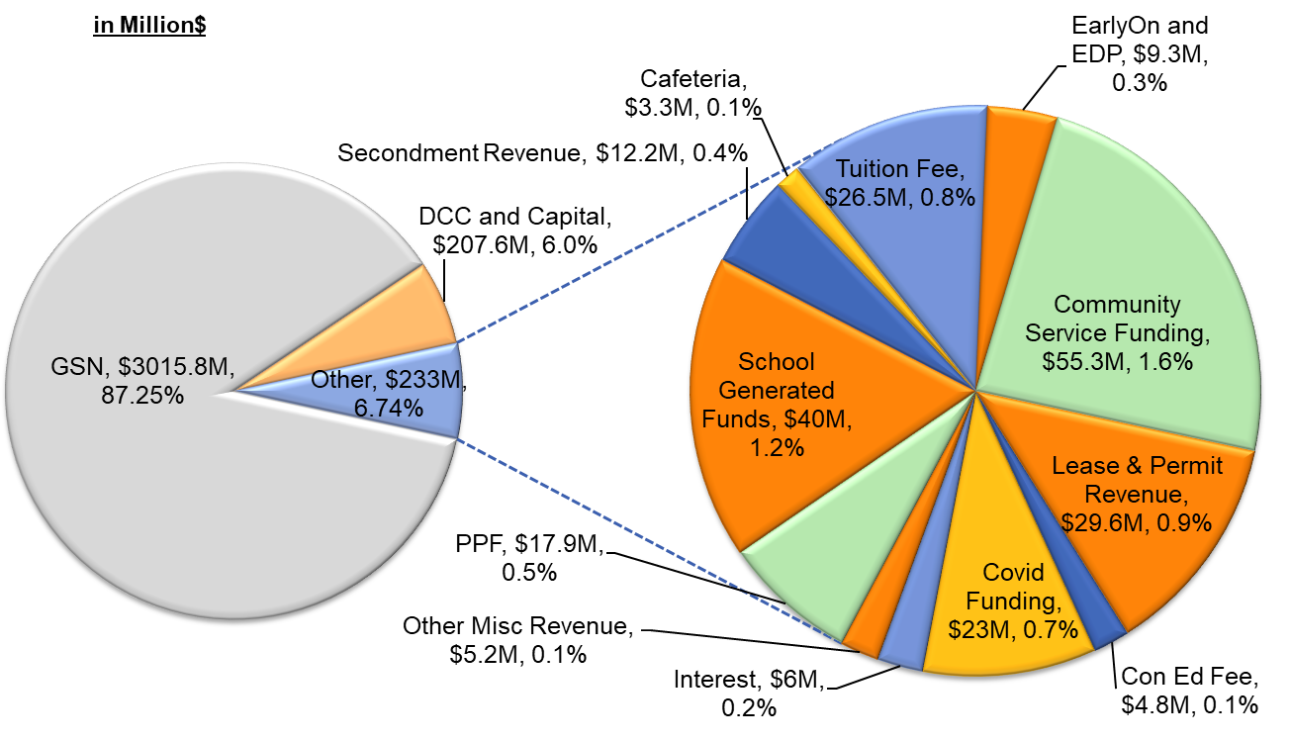
Key Components of Education Funding – 21-22 Revenues
TDSB’s projected revenues for 2021-22 is around $3.4 billion
*Figures based on 2021-22 Estimates
Notes:
As mentioned previously, the key driver of the Grants for Student Needs funding is enrolment. As enrolment increases, the grants will also increase to help offset the costs associated with servicing our students. Our projected revenues for 2021-22 is around $3.23B and $3B of this relates to the GSN funding. The remaining $232M is made up of other revenues, such as the revenues from community services funding, school fundraising, leasing and permits, tuition from international students, other one time COVID government support funding and the priorities and partnership funding. We also receive other revenue sources such as interest, program revenues and cafeteria sales.. This chart was presented at the June 1st Finance Budget and Enrolment Committee meeting and this chart does not yet capture the capital components such as the deferred capital contribution. We will be presenting a slightly revised revenue chart at the June 16th Finance meeting that will incorporate the capital budget components as approved at the June 1st private meeting.

Slide 21
Key Budget Components - 2022-23 Expenses
TDSB’s 2022-23 expenses are mainly comprised of the following:
Instruction - school-based staffing, administration and other program staff, learning materials, classroom supplies and equipment, staff training
School Operations - School operations and maintenance
Administration - Central department staffing and operation costs, utilities/maintenance of admin buildings
School Fundraising - Expenses from utilization of fundraising proceeds
Transportation - Pupil transportation costs
Amortization - Amortization of TDSB fixed assets
Renewal, Debt and Other - Expenses such as cost of financing and other miscellaneous costs
Notes:
This is a breakdown of TDSB’s expenses. Over 76% of our expenses relate to instruction, which is primarily staffing costs, learning materials and equipment for the classroom and staff training. Approximately 10% of the our expenses relate to school operations, which include cost of maintenance at our school sites. Each year we incur about $45M in fundraising costs, which is the utilization of our fundraising proceeds. And we also incur transportation, amortization and other costs each year.

Slide 22
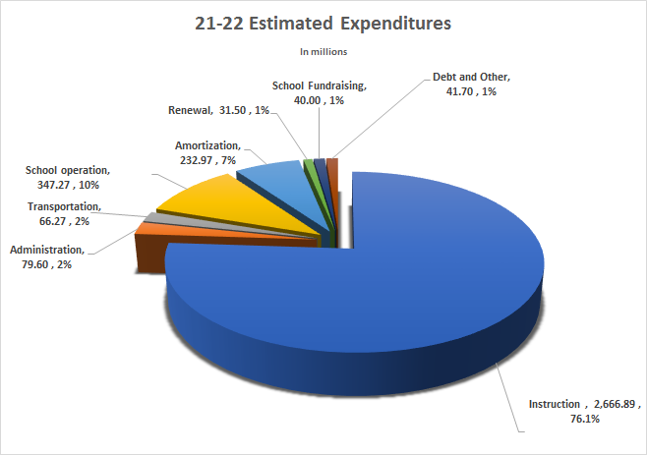
21-22 Estimated Expenditures
Notes:
This is a visual chart of the expenses, which shows that instruction makes up 76.1% of the expenditures. School Operation and Amortization make up 10% and 7% of the expenses. And other operating expenses make up the remaining 7% of costs.

Slide 23
2021-22 Financial Projection
(as of February 28, 2022)
 |  | $M | %
21-22 Financial Projection as reported at the January 13, 2022 FBEC - Surplus/(Deficit) |  | ($65.1) | -2.2%
Revenue changes Federal Safe Return to Class Fund- Ventilation Top-up Funding applied to existing costs Decrease in international student tuition revenues Decrease in permit revenues Total Revenue Changes | 1.5 (2.3) (1.0) | (1.8)
Compensation Expense Changes Central Department gapping and temp savings Increase in School based staff costs (net Q&E grant changes and supply teacher savings) Total Compensation Changes | 9.2 (12.0) | (2.8)
Operational expense changes Insurance cost savings Transportation costs savings due to periods of remote learning Net utilities savings due to periods of closures and use of COVID funding Decrease in international student expenses Decrease in aquatic program expenses due to closures Other central department in-year savings Total Operating Expense Changes | 2.7 2.5 2.2 0.8 0.8 0.9 | 9.9
Changes to financial position |  | 5.3
Updated 2021-22 Financial Position - Surplus/(Deficit) |  | (59.8) | -2.1%
Notes:
Now I will discuss our 2021-22 projected financial position. In this chart that we presented to trustees at the June 1 Finance meeting, we outline a projected deficit of $72.1M, which represents 2.4% of our operating budget. We have incorporated the new funding as announced in May, and have also accounted for the projected revenue and cost changes for the upcoming fiscal year. The link to our June 1st report is on our Board website and explains each of the revenue and cost item changes. This projection assumes that there will be no cuts to programs and services for the upcoming year, as we hope to ensure a smooth transition for students returning to school in September. By the end of August, we will have a better sense of the staffing requirements once the selection form process is finalized, and will then be able to identify the staffing cost impact on the 2021-22 bottomline.

Slide 24
2021-22 Projected Working Funds
and Unrestricted Reserves Balance
(as of February 28, 2022)
 | $M | %
Updated 2021-22 Financial Position - Surplus/(Deficit) | (59.8) | -2.1%
Working funds and unrestricted reserves balance - September 1, 2021 | 201.7
Projected use of working funds | (22.7)
Projected use of other unrestricted reserves | (37.1)
Projected working funds and unrestricted reserves balance- Aug 31, 2022 | 141.9
Notes:
Now I will discuss our 2021-22 projected financial position. In this chart that we presented to trustees at the June 1 Finance meeting, we outline a projected deficit of $72.1M, which represents 2.4% of our operating budget. We have incorporated the new funding as announced in May, and have also accounted for the projected revenue and cost changes for the upcoming fiscal year. The link to our June 1st report is on our Board website and explains each of the revenue and cost item changes. This projection assumes that there will be no cuts to programs and services for the upcoming year, as we hope to ensure a smooth transition for students returning to school in September. By the end of August, we will have a better sense of the staffing requirements once the selection form process is finalized, and will then be able to identify the staffing cost impact on the 2021-22 bottomline.

Slide 25
Use of Reserves
Currently forecasting a 2.1% deficit for the 2021-22 school year
Utilizing reserves to balance the budget to avoid reducing programs to students during the pandemic
As of August 31, 2021, TDSB has $22.7M in working funds reserve and $179M in other unrestricted reserve
For 2022-23, the Ministry will require school boards to return to the 1% deficit requirement
Ministry approval required if school boards anticipate an in-year deficit of greater than 1%
Notes:
Staff will be recommending on 16 June 2021 that reserves be used to balance the operating budget for the 2021-22 school year, and again this is to avoid reducing programs to students during the pandemic.
The Ministry of Education has announced additional funding to school boards if they are required to utilize more than 2% of their reserves over the 2020-21 and 2021-22 school years. This funding will be provided for any costs which exceed the use of reserves over 2%.
2% of our operating budget is approximately $59.0M. This means that the Ministry will potentially be funding TDSB at approximately $34.6M at year end 2021-22 based on financial statements. School boards are required to submit a balanced budget to the Ministry of Education by June 30th of each year. School boards can have a deficit of up to the lesser of 1% of their operating revenue or accumulated surplus for the preceding school year (as set out in Ontario Regulation 280/19). If a school board anticipates an in-year deficit of greater than 1% in its operating allocation, then they must seek the Ministry’s approval.

Slide 26
2022-23 Financial Projection (as of April 7, 2022)
 |  | $M | %
21-22 Financial Projection as reported at the January 13, 2022 FBEC - Surplus/(Deficit) |  | ($65.1) | -2.2%
Revenue changes GSN decrease relating to declining enrolment GSN increase – Teacher qualification & experience funding GSN increase – Broadband, mental health and other funding One-time COVID Learning Recovery Fund Decrease in EWPF and ISP funds Increase in international student tuition revenues Increase in interest income Increase in permit revenues Total Revenue Changes | (18.8) 8.5 8.4 31.5 (14.8) 4.5 2.5 3.0 | 24.8
Compensation Expense Changes Reduction in school-based staffing due to enrolment, net of rate changes Cost reduction from end of EWPF and ISP funds Increase in staffing costs from use of COVID Learning Recovery Fund Increase in central staffing costs, and CPP and EI increases Increase in long term disability costs due to rate changes Central staff gapping savings Total Compensation Changes | 18.2 14.8 (31.5) (4.6) (3.3) 5.0 | (1.4)

Slide 27
2022-23 Financial Projection (cont’d) (as of April 7, 2022)
 |  | $M | %
Operational expense changes Insurance cost savings Reduction in Board funded COVID expenses Utilities, and other facilities cost increases Total Operating Expense Changes | 2.0 1.0 (6.0) | (3.0)
Changes to financial position |  | 20.4
Updated 2022-23 Financial Position - (Deficit) |  | (44.7) | -1.5%

Slide 28
2022-23 Financial Projection (cont’d)
The 2022-23 preliminary financial projection is $44.7M, or 1.5% of operating allocation as of April 2022 and represents the current financial position before any adjustments arising from deficit reduction strategies.
Staff will identify strategies to reduce the 2022-23 projected deficit, while aligning with the Board’s strategic budget drivers and Multi-year Strategic Plan. Staff will bring a 3-year deficit recovery plan to the Finance, Budget & Enrolment Committee (FBEC) meeting on May 16, 2022, with the goal to reduce the deficit to 1% in 2022-23, and eliminate the deficit by 2024-25.
If the deficit reduction recommendations are not approved, TDSB must seek the Ministry’s pre-approval if they anticipate an in-year deficit of greater than 1% ($29.3M based on TDSB’s operating allocation).

Slide 29
Budget Challenges
The TDSB budget is a preliminary plan, and this plan could change if there are unforeseen commitments or events. Below are some risks that could have an impact to the budget:
Declining enrolment
Enrolment stabilization funding no longer available
Uncertainty around COVID-19 pandemic and availability of Ministry funding
Not all operating costs can be adjusted based on enrolment changes
Ministry funding benchmarks do not fully address annual cost inflations and TDSB’s unique needs
Funding gaps
Notes:
Staff have based the financial position of the Board on the most current information available. And as such there are unforeseen risks and challenges that may still impact our financial position.
There are underlying risks associated with our revenues. This includes permits, cafeteria sales, leases, international students, childcare and community programs. These areas are directly impacted by the pandemic situation and government restrictions.
Since the selection form release date has been postponed to mid-August, the allocation of teaching staff will not be fully finalized until late August 2021. The allocation of additional teachers will be targeted to support the re-engagement of virtual students returning to in-person learning in 2021-22.
Parameters considered in the allocation of teachers will be the percentage of students returning to in-person learning and the learning opportunity index (LOI) ranking of each school. Allocation of resources will be focused on student re-engagement and well-being.
Student enrolment has a significant impact on funding and is therefore continues to be a risk to any school board’s financial projection. The enrolment forecast will be updated in the fall after the October 31 count date. This enrolment information will be used to update the financial forecast for the Revised Estimates submission to the Ministry in November and included in the first quarter update to Trustees.
Under Use of Benefit Reserves – There is risk in using benefit reserves for the in-year deficit because should actuarial costs increase above the level of the remaining reserves, the additional cost would impact the operating budget of the Board.
And for Utilities Costs – any unforeseen fluctuations in pricing in the utilities market (if significant and above those budgeted) would impact the operating budget of the Board.
Pandemic Costs – While it is expected that the pandemic impacts will lessen over the upcoming school year, should there be a significant change in the course of the pandemic, and should no additional funding be provided by the Ministry, there could be an impact to the Board’s operations and financial position as well.

Slide 30
Other Budget Risks
Enrolment projection may deviate from actual results
Ongoing funding challenges may lead to reduction or cancellation of board-funded programs
Should the Board experience ongoing financial challenges, TDSB may not have sufficient reserves to cover these shortfalls
TDSB provides periodic updates to the Finance, Budget and Enrolment Committee on any changes to the budget throughout the year.

Slide 31
End

