Slide 1
Balancing the 2015-2016 Operating Budget Ward Forum Presentation

Slide 2
Introduction
Introduction of staff
Brief outline of presentation
TDSB Profile
Operating versus Capital Budgets
Budget Risks
2015-2016 financial forecast
Proposed options to balance budget
Next Steps
Capital Directions and Challenges
Questions and Answers

Slide 3
The Years of Action 2013-2017
Every Student, Every School, Every Day
Five areas of focus
Student Achievement & Well-being
Parent & Community Engagement
Staff Inspiration & Support
Fiscal Stability & Accountability
Education for Sustainable Development
We’ll have a balanced operating budget for 2015-2016 in March.

Slide 4
Profile
246,000 students in 589 schools
Over 100,000 adult learners
56% of students home language other than English
Annual operating budget of $3.1B
Funding Sources:
Provincial grants = $2.8B
Other revenues = $0.3B
Capital budget totaling $137M
29,000 school based and school support staff
1,200 central staff

Slide 5
Operating vs. Capital Budgets
Operating budget (March) and a Capital Plan & Budget (May)
An Operating Budget represents the annual expenditure plan for the board, supporting student learning and board operations.
The Capital budget is a plan for addressing growth and retrofitting school facilities.

Slide 6
Simplified Budget Process for 2015-16
In March, the Board will vote on the full operating budget for the 2015-16 school year.
Similar process to the 2014-15 budget cycle.
Goal of new approach is to provide a complete financial plan for well in advance of the start of the school year.

Slide 7
Enrolment Trends

Slide 8
Elementary Day School Enrolment (Head Count)

Slide 9
Secondary Enrolment

Slide 10
Operating Expenditure Plan
Note: Supplies and Services includes school budget, department supplies, maintenance and contract services.

Slide 11
Operating Expenditure Plan

Slide 12
Budget Assumptions
Projected enrolments
Number of classes and teachers adjusted to enrolment
Provincial grants based on 2014-15 funding model and announced changes
Inflationary adjustments (utilities and payroll taxes)
Contingency
Labour contract settlements funded through current funding model or additional funding

Slide 13
Budget Risks
Enrolment projections to actuals
Provincial grant changes
Inflation assumptions
Unanticipated events (weather, public health, labour disruption, government policy changes)
Legal

Slide 14
2015-2016 Projected Revenues Changes
Items | Amount (in millions)
Change in GSN revenue due to enrolment | $(24.9)
Special Education High Needs Amount | $(5.0)
Administration and Governance Allocation | $(0.5)
Declining Enrolment Allocation | $0.1
Change in Revenue year over year | $(30.3)

Slide 15
2015-2016 Projected Expenditures Changes
Items | Amount (in millions)
Changes due to enrolment and staffing demographics | $(17.3)
Other payroll and benefit changes | $1.5
Utility increases | $2.0
Contingency | $5.0
Change in Expenditures year over year | $(8.8)

Slide 16
Projected Financial Forecast
Items | Amount (in millions)
Grant and Revenue changes | $(30.3)
Projected Expenditure changes | $(8.8)
Projection Financial Position Surplus/(Deficit) | $(21.5)

Slide 17
2014-2015 Options to Balance
 | ($)
Options | Amount Recommended
Reduction in overtime in Facility Services | 900,000
Facilities productivity savings | 2,300,000
Non-school based staffing reductions through attrition | 2,500,000
Transportation alignment of costs | 1,000,000
Efficiencies in Permit department | 100,000
Attendance Management | 1,800,000
Efficiencies in Payroll Services | 200,000
Policy review of mileage claims | 100,000
In-Year Savings | 3,500,000
Total | $12,400,000

Slide 18
Proposed Options to Balance for 2015-16
 | ($)
Options | Amount Recommended
Total | $21,500,000

Slide 19
Budget Reductions Required in Prior Years

Slide 20
Operating Budget – Next Steps
Community Budget Sessions throughout February
Proposed Balanced Budget to Board March 11th
Community Information Sessions on Proposed Long Term Program and Accommodation Plan – April/May
Multi-year Proposed Capital Budget to Board end of May

Slide 21
Capital Directions and Challenges

Slide 22
Overview – The Context
The Renewal Challenge
588 operating schools
102 Schools below 60% capacity
66 properties sold
$405 M in proceeds
$3.0 B in current renewal needs
$5.6 B projected by 2028
226 schools in critical*condition
55 schools need extensive renovations
Capital funding for
growth since 2008-2009:
$107.3 M
The Growth Challenge
City’s Residential Intensification continues
Building applications for 275,000 residential units in process
Enrolment up by 20,000 students by 2039
$300 M lost in potential Education Development Charges
Annual grant for school renewal:
$45.5 M (2014-2015)
Grant for School Condition Improvement:
$29.4M (2014-2015)
*Ministry of Education FCI ranking: critical = >65%

Slide 23
Overview – The Reality
To finance growth and renewal needs, we need to sell properties.
The process takes
at least a year …
if all goes well.
The City and local communities fight to preserve school green space.
We need a
new strategy.

Slide 24
Ageing Schools  Need for Renewal
Facility Condition Index (FCI): Building industry standard for calculating facility condition on a scale from 1 to 100.
FCI rating: The ratio of a facility’s renewal needs to its replacement cost, expressed as a percentage.
Critical: FCI rating of 65% or greater; previously defined by Ministry as prohibitive to repair, (i.e., renewal not financially feasible: cost of needs too high compared to facility value).
current ministry fci ratings of open and operating tdsb school buildings
Fci category | fci rating range | number of schools
good | <10% | 63
fair | 10<fci<30% | 113
poor | 30<fci<65% | 155
critical | above 65% | 226*

Slide 25
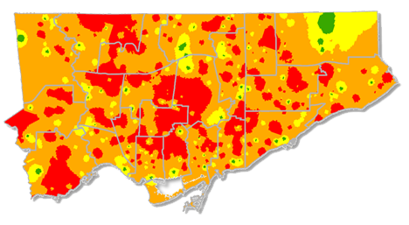
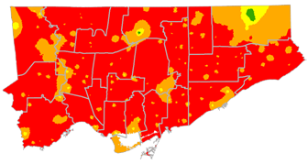
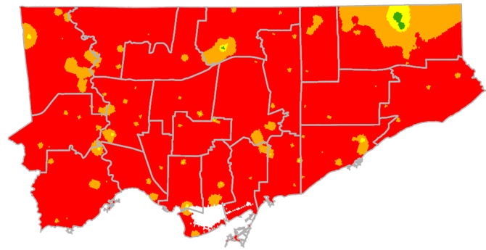
The Renewal Challenge
Facility Condition Index Projections
projected FCI 2019*
actual FCI 2014
projected FCI 2024*
Source: TDSB Planning Department
*these FCI projections are based on the most recent ministry FCI data and reflect the current (2014) status of tdsb’s infrastructure.

Slide 26
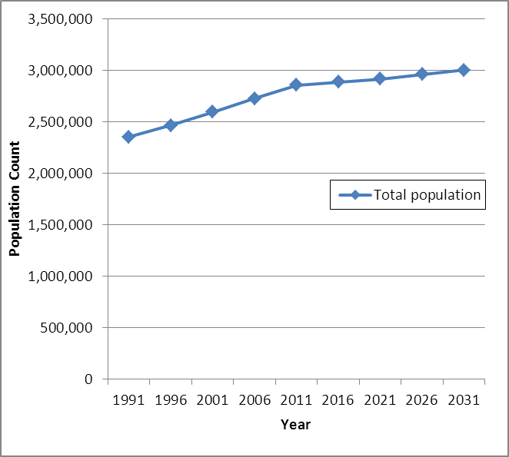
The Growth Challenge
City of Toronto Population Projections
By 2031, the City of Toronto will be home to 3.2 million people.
A fast-growing city
2,615,060: Toronto population in 2011
7.8% of Canada's total population (2011 Can. Census)
2014
Growing much faster than before
111,779: Toronto’s population increase from 2006-11
5 times the population growth rate during previous five-year period
Growing much faster than GTA as a whole
22.4% of all the growth in the GTA from 2006-2011, up from just 4.6% during 2001-2006
34.0% of GTA increase in occupied dwelling units between 2006 and 2011.
Sources: City of Toronto “Backgrounder”, Feb. 8, 2012; 2011 Canada Census, Population and Dwelling Counts
Note: The above projections include adjustments for undercoverage. Undercoverage is the portion of the population that is not captured by the Census.
Source: Flashforward: Projecting Population and Employment to 2031 in a Mature Urban Area, Toronto Urban Development Services, June 2002

Slide 27
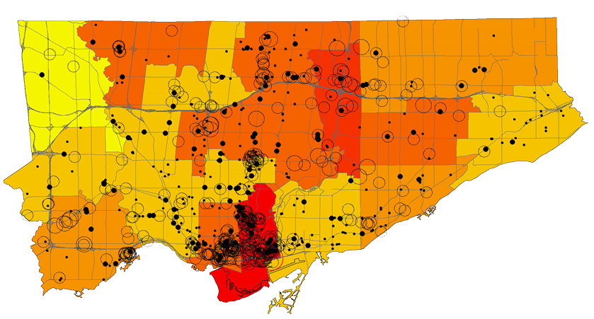
The Growth Challenge
Planned Future Residential Development
Current Active Development Project Applications expected to yield: 275,000 residential units 19,000 projected elementary TDSB students 10,000 projected secondary TDSB students
Source: TDSB Planning Department

Slide 28
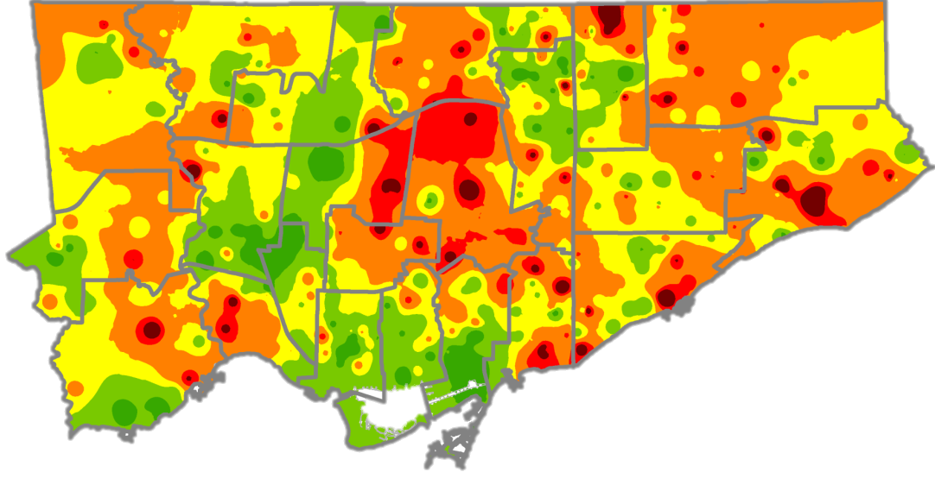
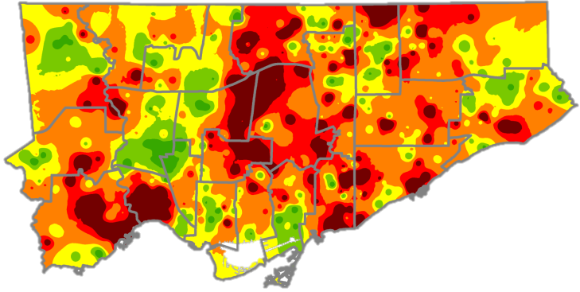
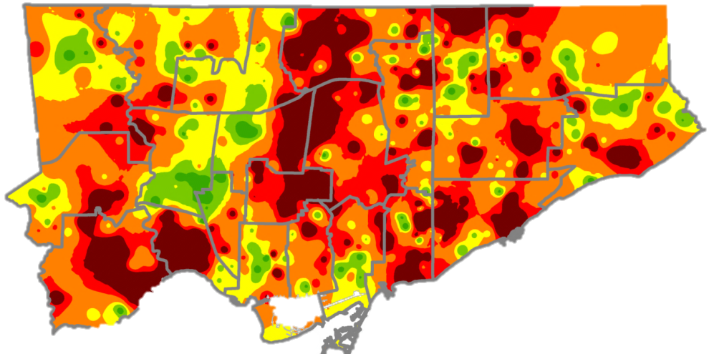
The Growth Challenge
Dispelling the Myth of Elementary Underutilization
actual 2012
projected 2017
projected elementary space requirements 2012–2032
projected 2032
Source: TDSB Planning Department

Slide 29
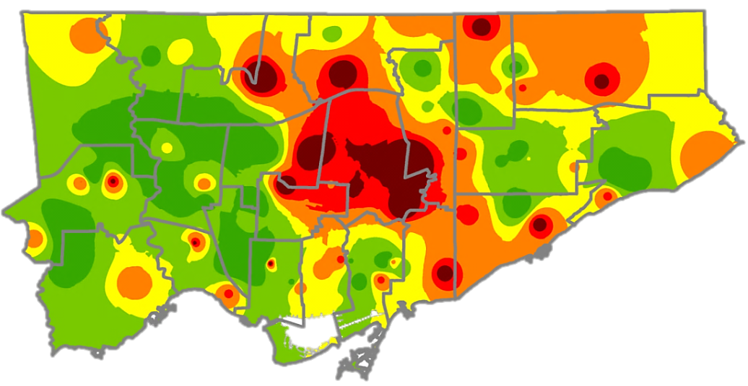
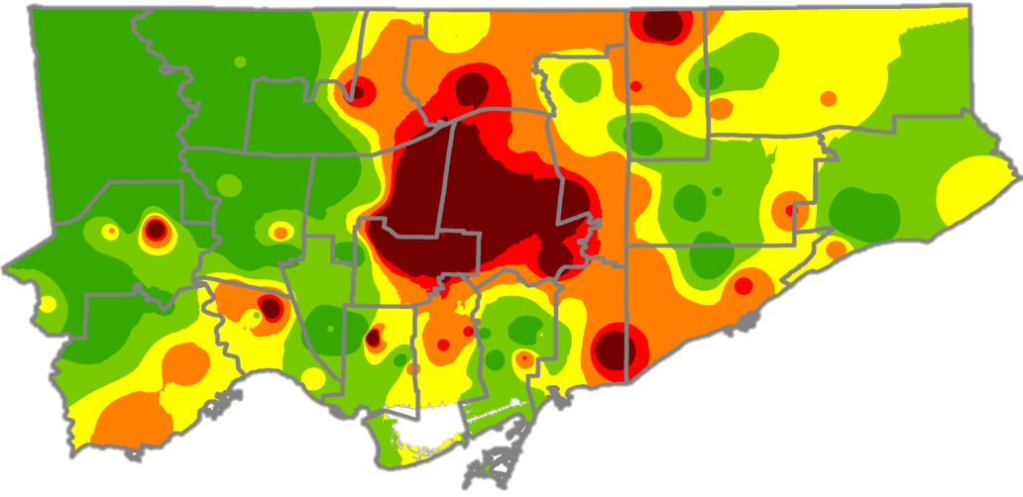
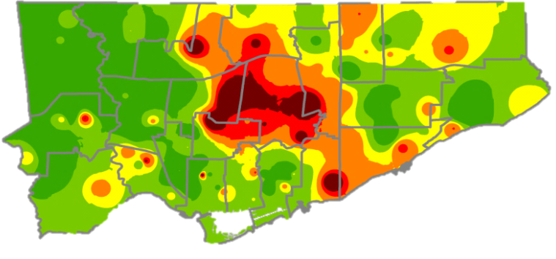
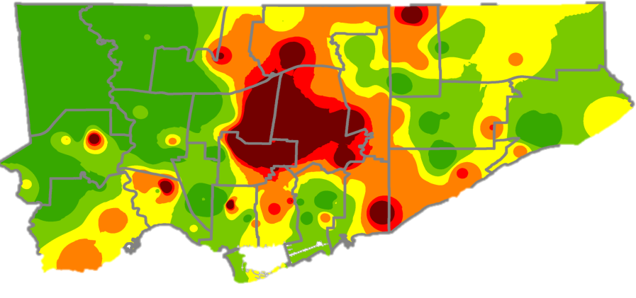
The Growth Challenge
Secondary Utilization: A More Complex Picture
Secondary numbers expected to return to 2013 levels by 2038. BUT other factors will affect actual capacity, including:
- Transit expansion - Unpredictable policy changes
actual
2012
projected 2032
projected 2017
Source: TDSB Planning Department
projected 2027

Slide 30
Choosing the Right Approach
concept: TDSB must have the same access to Provincial funds to support enrolment growth as all other Ontario school boards.
comments:
$2.4 B capital funding for Ontario school boards since 2008-2009
$ 107.3 M capital funding for TDSB since 2008-2009
12.6% TDSB percentage of Ontario students
5.2% TDSB percentage of Provincial capital funding

Slide 31
Choosing the Right Approach
2. Education Development Charges (EDC)
concept: Changes needed to the Education Development Charges Act.
comments:
New development having a substantial impact on existing schools.
TDSB expected to use proceeds from site sales in other communities to finance growth needs.
EDC regulation does not take Toronto’s Official Plan for residential intensification into account. Per O. Reg 20/98 , TDSB is ineligible due to projected excess capacity system-wide.
With 275,000 additional residential units in process over the next few years, TDSB has the potential to generate nearly $300 million in revenues to help support urgent school infrastructure needs for a growing City population.

Slide 32
Choosing the Right Approach
3. Capital Levy on Property Taxes
concept: Province introduces an infrastructure levy.
considerations:
Potential public concern regarding increased taxes i.e. impact on cost of living and doing business in Toronto.
comments:
Would help all school boards address infrastructure needs with sustainable annual revenue.

Slide 33
Choosing the Right Approach
4. Innovative Partnerships
concept:
Development opportunities for TDSB are based on future development in Toronto.
comments:
Opportunity limited to sites in areas undergoing development pressures:
Only about 25 possible viable projects.
Complex and time-consuming Municipal Planning process.

Slide 34
Choosing the Right Approach
5. Creating Community Hubs
concept:
Encourage special service sector to relocate into underutilized public schools.
comments:
Ministry of Education is encouraging the creation of community hubs.
Service supports to students would be conveniently located and easy to access.
Service partners would need to fund any facility improvements specifically required for their operations.
Requires complex operating agreements.
Requires compatibility to ensure success for the school community and the organizations.

Slide 35
Choosing the Right Approach
6. Reviewing School Sites
concept:
Consider program consolidations where student program can be enhanced.
comments:
Would require careful consideration of program consolidations.
May have long-term implications for the accommodation needs resulting from future growth.
Impact on community green spaces.

Slide 36
Questions?

