Slide 1
Healthy Growth and Development
Toronto District School Board

Slide 2
Growth and Development (1998). The Growth and Development expectations from the 1998 health and physical education curriculum have been included in this interim edition of the document pending further consultation on the expectations related to human development and sexual health that will be included in the final revised curriculum.

Slide 3
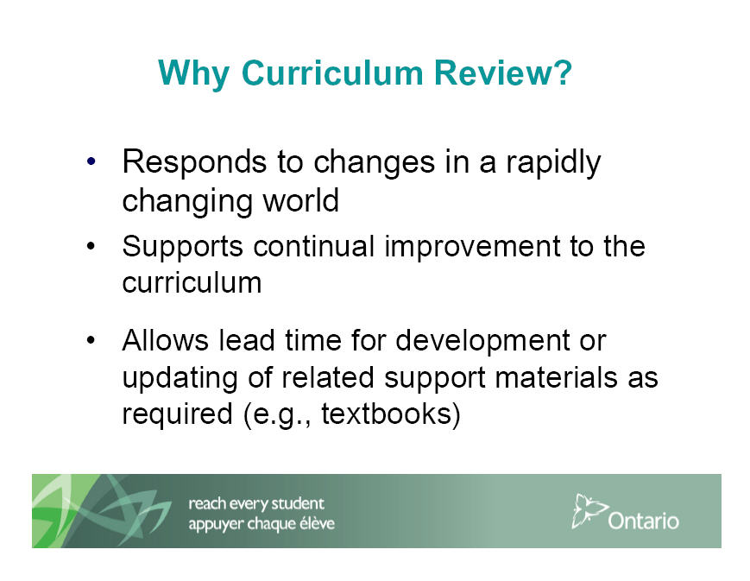

Slide 4
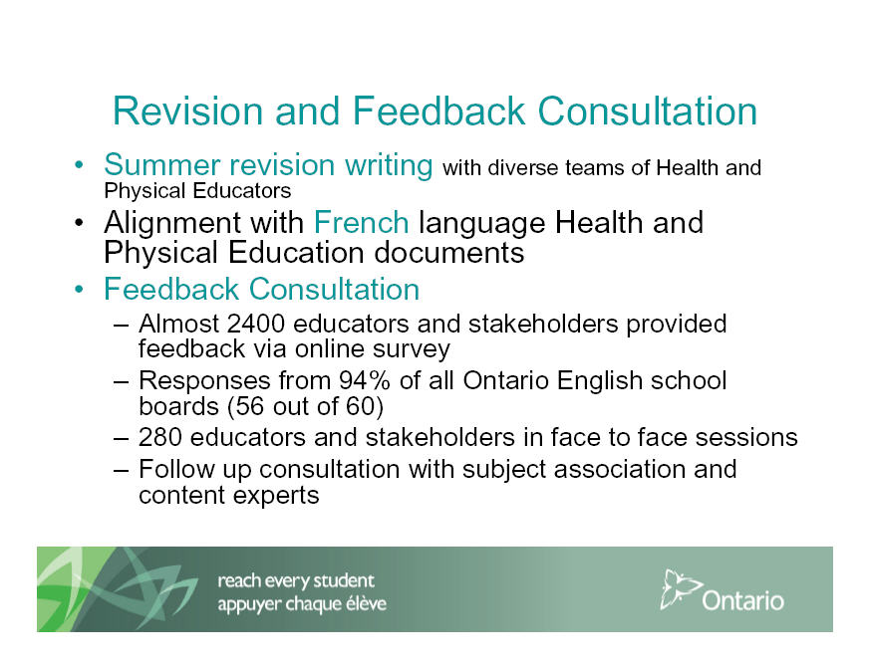

Slide 5
Parent Survey
Health and Physical Education Curriculum, Grades 1−8
October 30, 2014, the Ministry of Education noted that one parent from each of the province’s elementary schools will have the opportunity to share their perspectives on the Human Development and Sexual Health Component of the elementary HPE curriculum via an online survey.

Slide 6
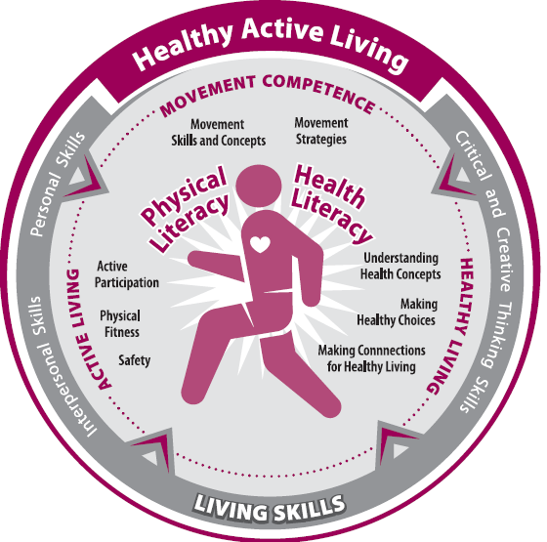
Notes:
Click on graphic or turn to page 5 of the curriculum.
Graphic shows the connections between the three strands of the curriculum
Helps to illustrate the Integrated, balanced, holistic intention of the curriculum – a shift from a focus on content to a focus on helping students practice and build skills for healthy active living

Slide 7
Growth and development education is more than simply teaching young people about the anatomy and physiology of reproduction. ….sexual development, reproductive health, interpersonal relationships, affection, abstinence, body image, and gender roles.
Pg. 35 The Ontario Curriculum Grades 1-8, Health and Physical Education 2010

Slide 8
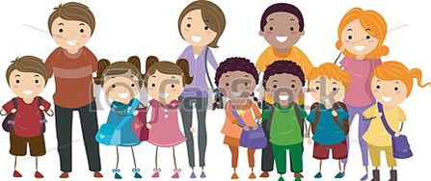
Parents and Guardians are the Primary Educators of their Children
Pg. 35 The Ontario Curriculum Grades 1-8, Health and Physical Education 2010

Slide 9
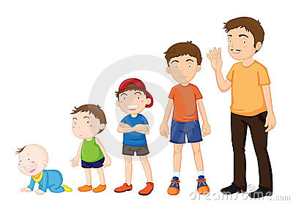
Teaching Growth & Development in Health & Physical Education

Slide 10
Curriculum Expectations
Healthy Living Strand:
Healthy Eating
Personal Safety and Injury Prevention
Substance Use, Addictions and Related Behaviours
Growth and Development

Slide 11
Curriculum Expectations
Growth and Development: Grades 1 – 12
Grade 1
Students will identify the stages in development of humans (e.g., comparing physical changes from birth to childhood) and other living things
Grade 12
Students will describe how society and culture affect individual perceptions and expressions of sexuality

Slide 12
VISION
The revised health and physical education curriculum is based on the vision that the knowledge and skills acquired in the program will benefit students throughout their lives and help them to thrive in an ever-changing world by enabling them to acquire physical and health literacy, and to develop the comprehension, capacity, and commitment needed to lead healthy, active lives and to promote healthy, active living.
Notes:
Click on “Vision” or turn to Page 3 of the curriculum
Goals of 1998 curriculum – help students develop comprehension, commitment, capacity to lead healthy active lives.
Enhanced 2010 vision includes goal of helping students thrive in an ever-changing world
Developing Physical and health literacy
Leading AND promoting

Slide 13

Together we can build healthy active schools.
Notes:
13
High-quality instruction and programs, including the Health and Physical Education curriculum is a foundational piece of a Healthy School.

