Slide 1

Toronto District School Board
A Vision for Learning in TDSB
A Process for Engagement in School Effectiveness
and School Improvement
Student Learning in a Culture of Shared Leadership

Slide 2
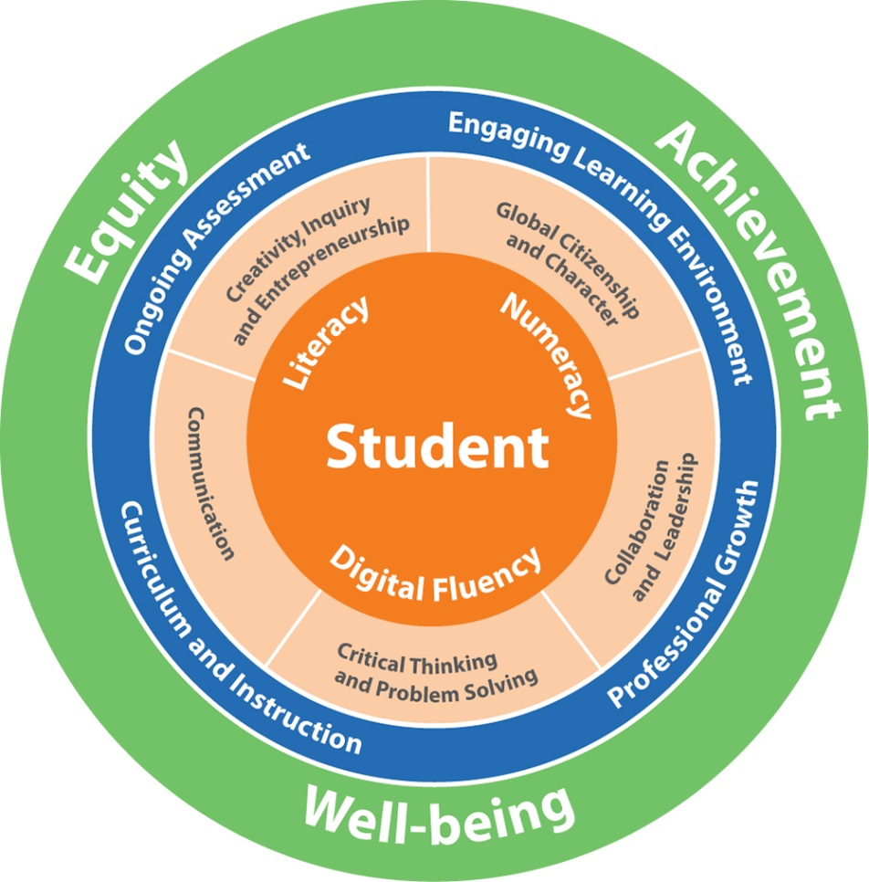
TDSB Vision for Learning
We have a foundational commitment to equity, student achievement, and well-being, supported by technology through the lens of global competencies.
Action:
Every school, in partnership with their superintendent and school community, will develop authentic foci where equity is embedded throughout the school community.
It is through equity, that we will enable student achievement, well-being and learning.

Slide 3
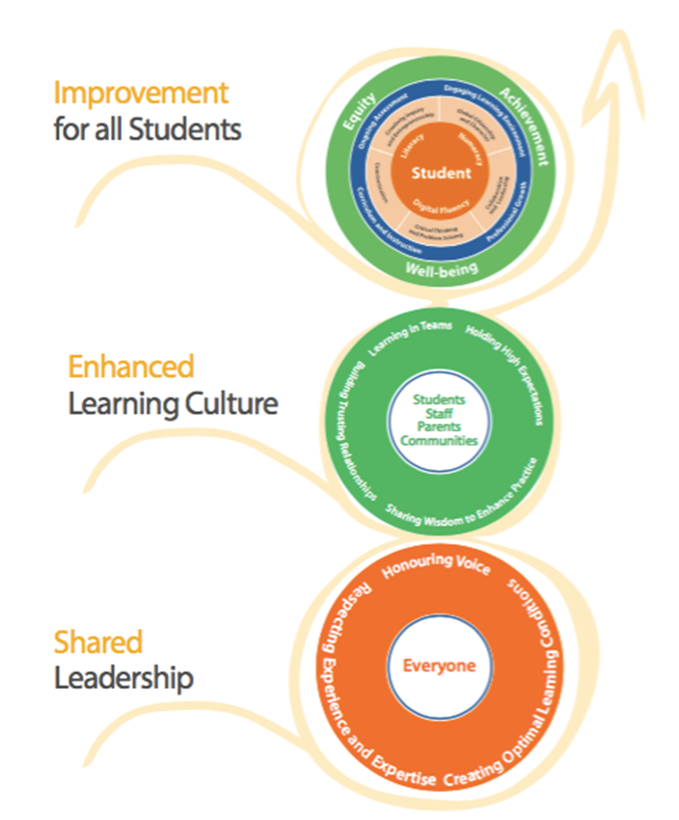
Leadership that Engages and Empowers All
We are building a system that supports student learning in a culture of shared leadership.

Slide 4
Shared Leadership
Sharing new learning and solving challenging issues
Promoting questioning
Working in collaborative trusting teams
Encouraging innovation and creativity
Infusing global competencies through the lens of equity using rich authentic learning tasks
Holding high expectations for all learners
Building relationships that are positive leading to increased engagement and empowerment of students, staff, parents and communities

Slide 5
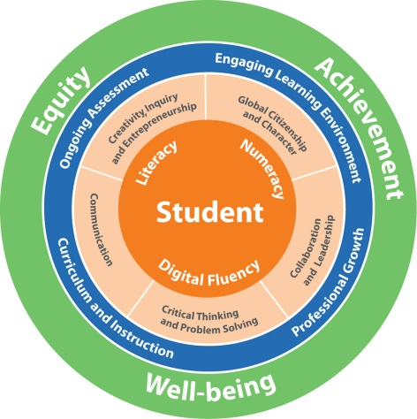
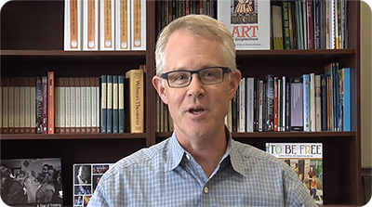
Our process for engagement
In the TDSB, a school’s strategy is not simply about the number of students or its EQAO scores. A school’s strategy is a collection of choices made by every individual in the school. Each and every school’s strategy is unique and its choices must reflect its needs, its communities and its goals. Principals will create conditions for shared leadership in collaboration with all learners.
This collaborative inquiry process will support your team in:
Developing authentic learning foci in equity, well-being and achievement through the lens of global competencies
Exploring rich conversations that help your team to share their thinking
Taking meaningful actions, supported by data, to achieve the TDSB Vision for Learning
This process will enable each and every school to build shared leadership through equity.
Link 1 (http://www.tdsb.on.ca/AboutUs/DirectorofEducation/VisionforLearning.aspx)
Link 2 (Vimeo)

Slide 6

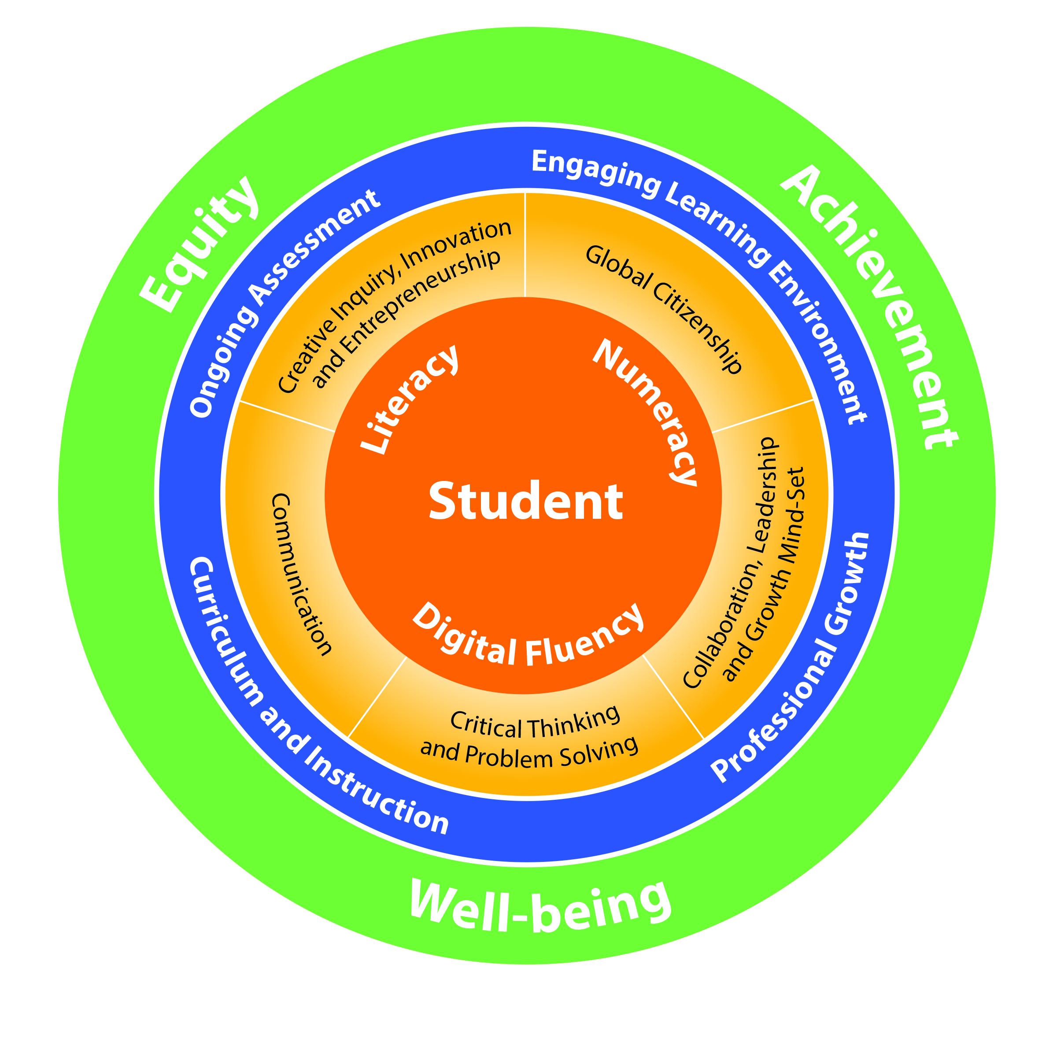
6 Key Conversations for Building Shared Leadership
Sept - Oct
Nov
Nov +
1
2
3
4
Thinking
6
5
Action
Together, superintendents and principals, will have 6 key conversations to develop a strategy that supports the school’s goals of equity, well-being and achievement:
1
Where are we now?
We start by examining data. By analyzing qualitative , quantitative and perceptual data, we determine: Where are we now?
4
How do we know?
What gets measured, gets done. We leverage evidence, data and success criteria to identify the key indicators to understand the impact of our actions.
2
Where are we going?
Reflecting on the data we begin to focus our thinking to develop three foci - one each for equity, well-being, and achievement for the school.
5
Act!
Moving beyond thinking, we take action to achieve the results that our school is working on together.
6
What change will we make to our thinking and behaviour?
At this stage, we reflect on what has been accomplished to re-focus our efforts and determine if our thinking or actions might need to shift.
3
What do we need to learn?
In order to achieve our goals we need to identify the capabilities our learning community : What do we need to learn together?

Slide 7

Building Shared Leadership
Key Conversations: Where are we now?
1
Where are we now?
We start with examining data. By bringing together qualitative, quantitative and perceptual data we reflect by asking ourselves: Where are we now?
Resources
Vision for Learning, pages 5 and 6
Data Dashboard including: demographic data, achievement data, well-being/experiential data
Meaningful equity, well-being and achievement foci aren’t always obvious. They need to come from a deep understanding of your current context: inspired by nuanced insights and triangulation of data. To start, explore data about your school, students and community; build on this with qualitative data drawn from your experiences and that of your colleagues. Our goal in this conversation is to have a deep exploration of our current context and to identify areas of opportunity for improvement.
Guiding Questions*
Who is not learning?
What do I believe to be true about equity in my school? Consider: Content, Pedagogy, Access and Climate, What data confirms my beliefs? What data disconfirms them?
What do I and our school community believe to be true about what certain groups of students are able to achieve? What biases are influencing these beliefs?
What do I not yet understand about the barriers that exist in the school that might keep students from achieving?
What Global Competency are our students struggling with? What equity barrier is in their way?
Inputs
Review the Vision for Learning
Gather data, both quantitative, qualitative and perceptual from board resources and your class of learners
In the next conversation…
Reflecting on the data we begin to focus our thinking to develop our core foci for the school.

Slide 8
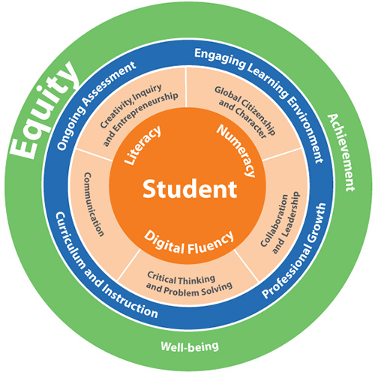
Let’s get started
The lens of equity is relevant to all our schools.
Who is not learning?
What are we doing to address barriers, biases
and oppression?
(Voice Over 1)
(Voice Over 2)

Slide 9
Equity
Equity and inclusive education aims to understand, identify, address, and eliminate the biases, barriers, and power dynamics that limit students’ prospects for learning, growing, and fully contributing to society.
Barriers may be related to sex, sexual orientation, gender identity, gender expression, race, ethnic origin, religion, socio-economic background, physical or mental ability, or other factors.
It is now recognized that several factors may intersect to create additional barriers for some students. These barriers and biases, whether overt or subtle, intentional or unintentional, need to be identified and addressed.

Slide 10
Exploring Equity (1/3)
The outcome of exploring the data will be that each school identify three goals, one each in the areas of equity, well-being and achievement. This exploration will include consideration of content, pedagogy, access and climate, and takes into account school climate, safe schools, demographic and achievement information.
Content:
What are we teaching (curriculum)?
How do we ensure the curriculum is inclusive and includes a variety of knowledge of all peoples as the basis for instruction?
Whose voices are missing and how do we change that?
How do we ensure students acquire the skills and knowledge that enable them to challenge unjust practices, and to build positive and healthy human relationships among their fellow students, and among all members of society?

Slide 11
Exploring Equity (2/3)
Pedagogy:
How do we encourage and support student voice?
How do we demonstrate commitment that all students are capable of learning and achieving?
How do we engage in conversations about bias and who is achieving/not achieving?
How do we demonstrate commitment to equity and inclusion?
How do we engage in culturally relevant and responsive pedagogy?
Do we employ a variety of assessment strategies as well as instruments used to inform short and long-term planning to reduce gaps in student achievement and improve student learning and well-being?
Do we support co-curricular activities that offer student opportunities to achieve success outside the classroom that can contribute to their engagement in learning and success inside the classroom (e.g. before and after-school child care and/or programs that are focused on sport, recreation, the arts, and culture)

Slide 12
Exploring Equity (3/3)
Access:
What are the physical barriers to access (e.g. washrooms, ramps, site safety, special needs equipment, breakfast programs, etc.)?
Are the social barriers to access (e.g. language, information and data collection, dress codes, school fees, social emotional supports, etc.)?
Climate:
How do we ensure the school environment is welcoming for all (students, staff, parents/guardians, and community)?
How do we support student engagement opportunities?
Do students see diversity and equity represented widely?
How do we ensure students have input into dress codes and school codes? Is safety an issue? Is there a means of safe reporting? Do students understand the causes and impacts of inequity in society, and understand the similarities, differences, intersectionality of multiple social identities and the connections between different forms of discrimination?
Nora Allingham, 1992 (From: District Process Guide, TDSB, Pg. 2).

Slide 13
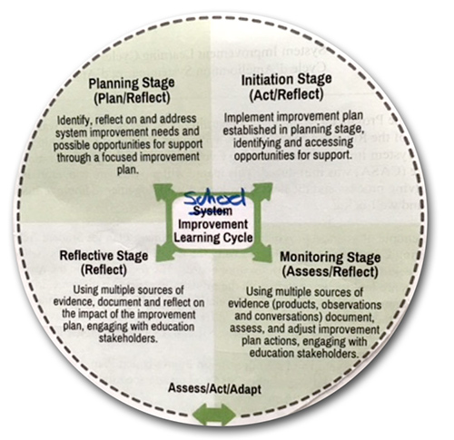

Our process is circular
The process is a circular, iterative process that supports each school in their own journey. Like the System Improvement Learning Cycle, at each stage of the process, there will be planning, acting, assessing and reflecting. The process is staged to make explicit the outputs and interactions that facilitate the process. As we explore this process, there are fundamental questions that frame our conversations – these are our guiding questions.
While the process is circular, the output must be:
Concrete and actionable
Specific to the school and authentically created for each school
Demonstrate the thinking between leaders and collaborators
3
What do we need to learn?
2
Where are we going?
4
How do we know?
1
Where are we now?
5
Act
6
Our starting point
6
What change will we make to our thinking and behaviour?
Adapted from Ministry of Education System Improvement Learning Cycle

Slide 14
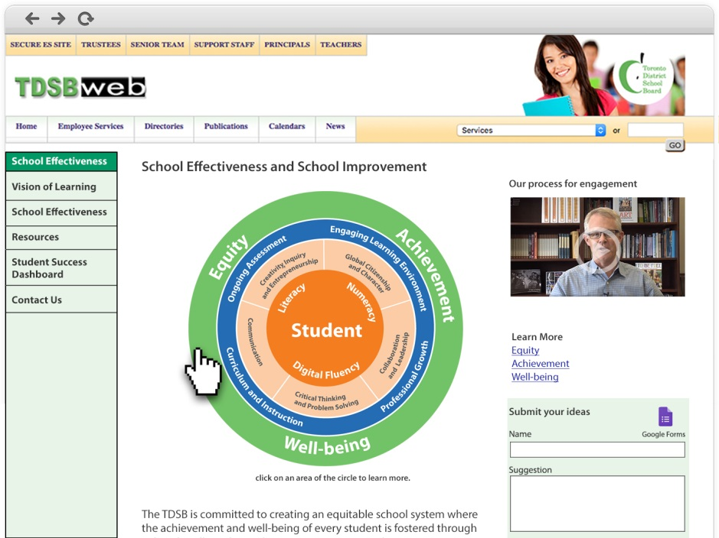
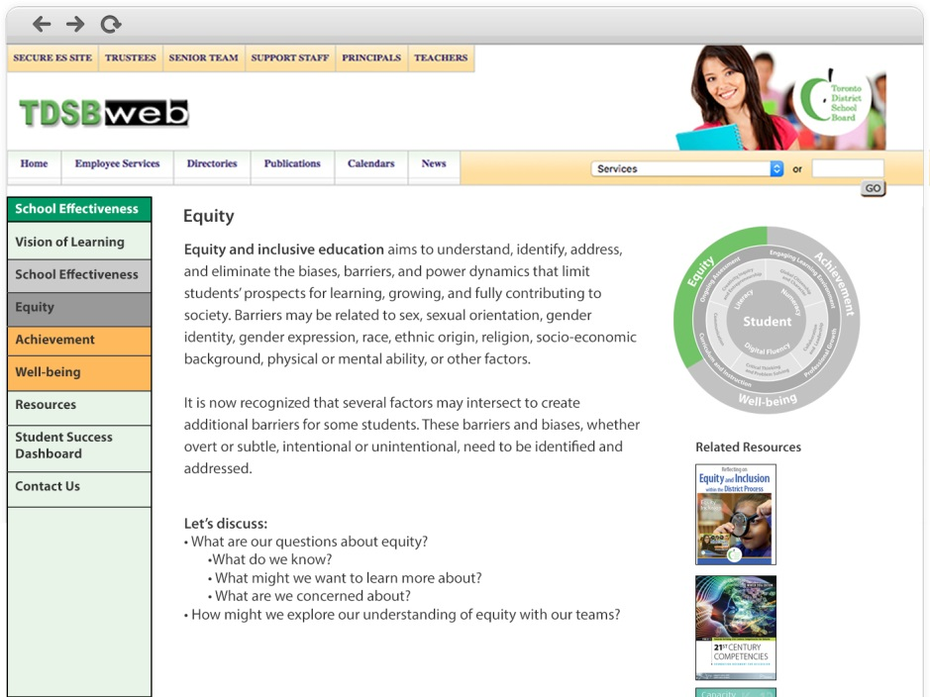
Begin exploring
The online resource will also include information that will give you a deeper dive into areas in our Vision for Learning. You will be able to click on areas of the Vision for Learning for access to further information and resources. As schools engage in this process, this is a living site with a central repository where others can contribute.
Landing page for School Effectiveness and School Improvement
Mock-up of Equity landing page with information and resource to explore.

Slide 15
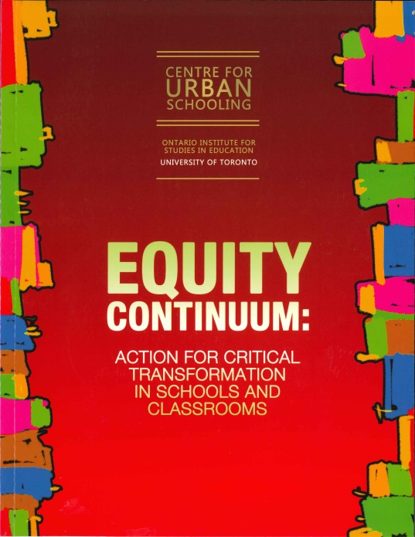
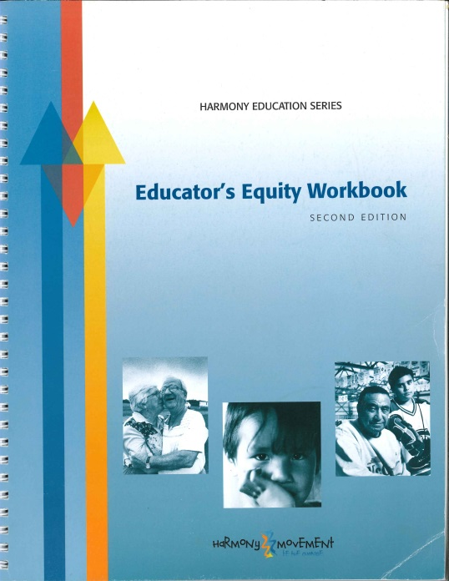
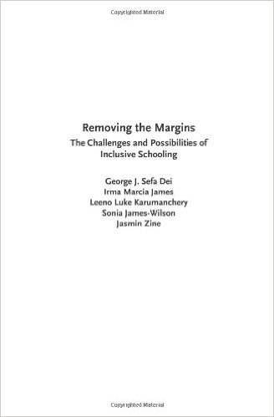
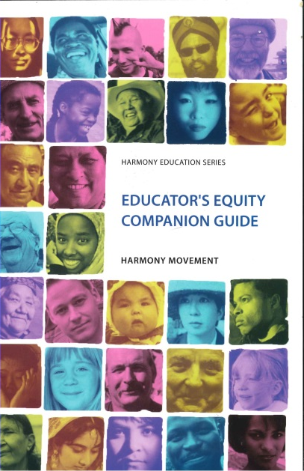

Resources

Slide 16




Resources

Slide 17


Resources

